Slide 1
“Biblical” Racism
How Literalism Can Produce Disastrous Results

Slide 2
Questions
How did theories of race in W. Europe develop from, and utilize, the Bible?
On what basis did Christians before, during, and after the Civil War justify slavery using the Bible?
How was the idea of humanity being created as/in God’s image sidestepped in such a view?

Slide 3
BACKDROP

Slide 4
Backdrop
Age of Exploration
  Late 15th century onward
“Old World” populations were relatively explainable in light of the Bible
ANE / Mediterranean
But China, Pacific Islands?
Across the Atlantic??

Slide 5
Backdrop
Discovery of the “New World”
  The Americas
What they would encounter was unknown
Conceptions influenced by mythology from antiquity > Middle Ages

Slide 6
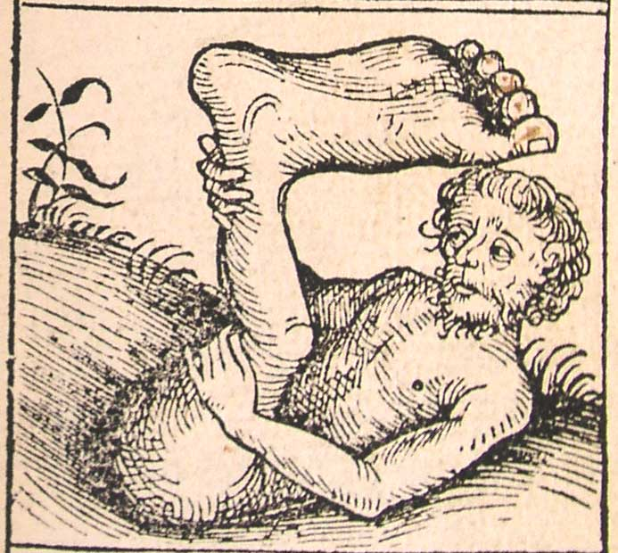
Backdrop
Monopods
Aka, skiapods
from σκιάποδες - "shadow feet" in
Greek
Why?
From the Nuremberg Chronicle, 1493

Slide 7
Backdrop
Ancient writers
  Pliny the Elder, Natural History
  sightings India
Church authorities
  Augustine, The City of God, Book 16, chapter 8:
  "Whether Certain Monstrous Races of Men Are Derived From the Stock of Adam or Noah's Sons.”

Slide 8
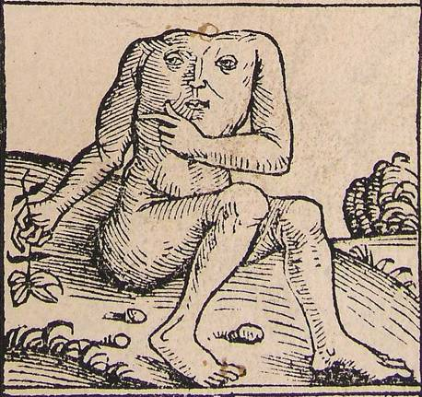
Backdrop
The Blemmyae
People without necks, having eyes in their shoulders
live in Africa and India
Pliny, Natural History, 57-58
From the Nuremberg Chronicle, 1493

Slide 9
Backdrop
Decipherment of ANE Languages
  19th century onward
Lengthy Histories & Chronologies
  Produced severe problems for biblical chronology as articulated by Bishop Ussher (17th century)
  e.g., Ussher’s flood date (2348 BC) overlapped with the pyramid age
Clear parallels to biblical stories of human origins, pre-flood civilizations, flood.

Slide 10
Backdrop
Enuma Elish
Atrahasis
Sumerian King List
Memphite Theology
King lists

Slide 11
Backdrop
Decipherment of Sanskrit
  17th-18th century
Lengthy Histories & Chronologies for civilizations outside the biblical world
Alternative stories of human origins

Slide 12
Backdrop
Decipherment of Sanskrit
19th century
Study of Sanskrit was central to the field of comparative linguistics of the Indo-European languages.
Sanskrit was discovered to be an Indo-European language
Era of higher criticism and Darwinism

Slide 13
Backdrop
Speculations / Questions
Why other peoples not mentioned in the Bible?
Biblical authority in human origins?
Maybe other civilizations had it right.
European Sub-text: How do we explain our racial heritage vs. others?
  Indo-Europeans weren’t Semitic
  Aren’t we the people of God? (Christianity / W. Civ)

Slide 14
Pre-Adamism
“At the beginning of the modern period, controversies having to do with the extent and the causes of human diversity were motivated by a genuine concern to make sense of the new ethnographic and physical-anthropological information that was flooding into Europe as a consequence of the rapid rise of exploration, trade, and colonization….

Slide 15
Pre-Adamism
“…. One of the most controversial interpretations of this new information, the theory of polygenesis, effectively deprived Christian scripture of its supposedly universal authority by decoupling the origins of ‘pagan’ peoples from the account given in the book of Genesis of the origins of those humans whose generations extend back to Adam and Eve.”
Justin E. H. Smith, “The Pre-Adamite Controversy and
the Problem of Racial Difference in 17th Century Natural Philosophy”

Slide 16
Backdrop
Posturing
Unbelievers / biblical critics
  Divorced Bible from human origins
    Darwinism, Geology, paleontology
    Literalized mythology, literalized content of other ancient texts, outright speculation:
      Theosophy, Alternative histories, Ariosophy, Hollow earth
  Anti-Semitism gets a new, added rationale

Slide 17
Backdrop
Posturing
Believers
  Harmonize origin stories and these other histories with the Bible
  Have to find these other humans in the Bible
    Have to do so “literally” (make the Bible say these things)
    Effort to retain biblical authority produced bizarre readings and interpretations of text.

Slide 18
“SOLUTIONS”

Slide 19
Solutions
Broader Issues
Geological time, fossils
“Gap Theory”
  Long ages of time, death before fall (fossils)

Slide 20
Solutions
Racial / Human Origins Issue
Pre-Adamism
Co-Adamism
    = polygenism
Point: Other races were non-Adamic
    Pre-existent (Gap Theory; Cain’s wife)
    Serpent seed (Cain)
    Nephilim bloodlines
    Result of cursing (Ham)

Slide 21
Pre-Adamism
Actually around before modernity
Traces in church fathers
Kabbalistic literature
See David N. Livingstone, Adam’s Ancestors: Race, Religion, and the Politics of Human Origins (Johns Hopkins University Press, 2011)

Slide 22
Pre-Adamism
Controversial
First major articulation:
  Isaac de la Peyrere (1596- 1676), a Calvinist of Portuguese Jewish origins from Bordeaux
    Men Before Adam. Or a Discourse upon the Twelfth, Thirteenth, and Fourteenth Verses of the Fifth Chapter of the Epistle of the Apostle Paul to the Romans. By Which are Prov'd, That Men Were Created before Adam (London, 1656)

Slide 23
Pre-Adamism
Focused on explaining Paul's words that "Until the law, sin was in the world; but sin was not imputed, when the law was not."
  Peyrere didn’t believe this was a reference to the Mosaic law, but to a law given to Adam.
  Implication: There must have been humans before Adam.
  Also opted for a local flood.

Slide 24
Pre-Adamism
Peyrere was not a racist.
Not descending from didn’t mean Negroes, for example, were animals (as others would later argue in the 19th century).
Motivated by the question of the extent of scriptural authority and the need to take seriously non-biblical chronologies and physical differences in people in both Old and New World.
Wasn’t concerned with establishing the inequality of the races

Slide 25
Pre-Adamism
Pre-Adamism was considered heretical by many when the idea was put forth, gained a few adherents as time went on, esp. once the Gap Theory was put forth.

Slide 26
Pre-Adamism
“Britain and America practitioners of science were generally drawn from the ranks of the religious and social establishment. Since British and American students of nature and human nature thus continued to ground their scientific endeavors in natural theology, frequently in a biblicist mold …

Slide 27
Pre-Adamism
. . . it was necessary to find some means of integrating the findings of the new sciences of ethnology, archaeology, human geography and anthropology with theological principles. In this context pre-adamism therefore provided one convenient-albeit frequently contested-vehicle by which human science and biblical theology could remain bound together.”
David N. Linvingstone, “The Preadamite Theory and the Marriage of
Science and Religion,” Transactions of the American Philosophical
Society, New Series, Vol. 82, No. 3 (1992),

Slide 28
Pre-Adamism
“. . . It was presumed that because it is the man of the Bible who is created in the image of God, if people on the other side of the world had a separate creation, then they could not but be seen as unequal, in terms of relative likeness to God, to those in the Christian world.”
Justin E. H. Smith, “The Pre-Adamite Controversy and
the Problem of Racial Difference in 17th Century Natural Philosophy”

Slide 29
Pre-Adamism
By the 19th century …
Many found it a welcome idea to divorce the Negro and the Native American from Whites when it came to having common ancestors from the Garden of Eden.
Monogenism required that thought; polygenism did not.

Slide 30
Pre-Adamism
In some contexts, missionary work suffered (“let them alone, they aren’t descended from Adam and Eve; they aren’t like us.”)
This soon shifted in the 19th century to “let’s dominate them”
  If they didn’t descend from Adam and Eve, they weren’t created in God’s image
  Negroes and others were considered “animalistic” for that reason
  Especially prevalent 19th century America

Slide 31
Pre-Adamism
“Racists like physician Charles Caldwell, physician Samuel G. Morton, and surgeon Josiah C. Nott all argued that the white race was the only race descended from Adam, and thus capable of salvation in the eyes of the Lord. The other races, but especially the Black, were separate and inferior creations. Buckner H. Payne and Charles Carroll declared Blacks to be pre-Adamite “beasts” who were stowed in the Ark with the other animals. . . .

Slide 32
Pre-Adamism
“. . . . Carroll denied Blacks had souls since pre-Adamites wouldn’t have had any before God invented them for the white Adam and his kin. Even those who accepted the theory of evolution got in on the game: Alexander Winchell said Blacks were too inferior to have ever evolved into something like Adam; therefore, only God could have directed evolution to produce the white race.”
Jason Colavito,
"Ancient Aliens," the Pre-Adamites, and Victorian Racism

Slide 33
Pre-Adamism
Eventually, polygenism fueled:
the Aryan invasion theory and Aryan master race ideology adopted and modified by the Nazis

Slide 34
Pre-Adamism
White Europeans . . .
Descended from God (gods in occult mythology)
Inherited status as “people of God” via Christianity and geographical domination of Christianity
Jews (Semites) cast off (Aryan myth made them animalistic)
Non-whites were animalistic

Slide 35
Conclusion
The Bible doesn’t justify racism
The Bible was not written to comment on racial differentiation
The Bible wasn’t meant to a be a science book or a commentary on science
Literalism in the name of defending the Bible as something it was never intended to be is flawed thinking, and can have disastrous results.

