Slide 1
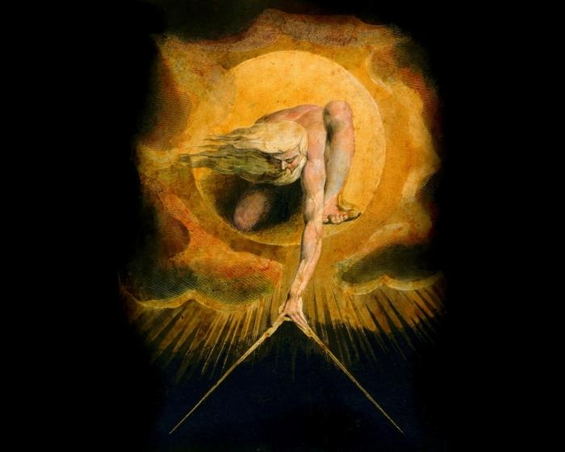
Gnosticism, the Gnostic Christ, and the Gnostic Gospels

Slide 2
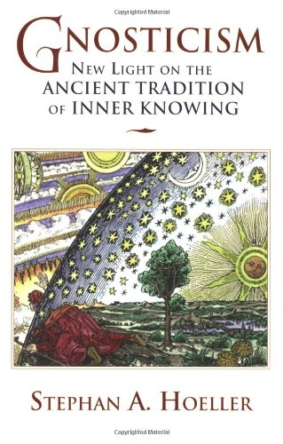
Preliminary Summary
What does Gnosticism seek to provide?
What spiritual help does it offer?
www.gnosis.org

Slide 3
Preliminary Summary
Gnosticism is the teaching based on gnosis, the knowledge of transcendence arrived at by way of interior, intuitive means.
“Knowing God” (this transcendent One) is not achieved by external revelation
The means is internal
Therefore requires an awakening

Slide 4
Preliminary Summary
Suggests that there is something we don’t know that needs to be known.
That “something” is Gnosticism’s story, the realization of which is what produces salvation.

Slide 5
Preliminary Summary
Gnosticism fundamentally recognizes:
Earthly life is filled with suffering.
All forms of life consume each other, thereby visiting pain, fear, and death upon one another.
Natural catastrophes bring further suffering and death in their wake.
Something isn’t right about the world

Slide 6
Preliminary Summary
Many religions advocate that humans are to be blamed for the imperfections of the world.
The “Fall” of humanity
  Judaism
  “Orthodox” Christianity
Gnosticism rejects this idea.

Slide 7
Preliminary Summary
Gnosticism argues that blame for the world’s failings lies not with humans, but with the creator.
Since -- especially in the monotheistic religions -- the creator is God, this Gnostic position appears blasphemous.

Slide 8
GNOSTIC
COSMOLOGY & THEOLOGY

Slide 9
The (Ultimate) Beginning
“True God”
A pre-existent, uncaused, perfect being; “the Light”

Slide 10
The (Ultimate) Beginning
“True God”
male/female aspects
These aspects (father/mother) bring forth many “emanations”

Slide 11
The (Ultimate) Beginning
“True God”
“emanations”

Slide 12
The (Ultimate) Beginning
“True God”
“emanations” … aka = AEONS

Slide 13
The (Ultimate) Beginning
“True God”
AEONS = PLEROMA

Slide 14



The (Ultimate) Beginning
“True God”
The created universe / material world we know
Doesn’t exist at this point
Notes:
At this point, read from the Gnostic Homily and a couple bridal chamber passages.
Sophia is driven by the sexual, procreative, regenerative urge; this is sin in that she refuses approval and a consort.
Her desire is holy in that she wants to be like the Father

Slide 15
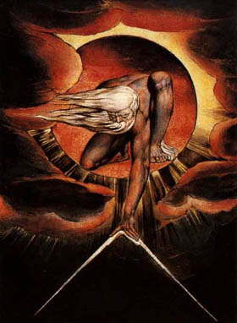
The (Ultimate) Beginning
“True God”
SOPHIA

Slide 16





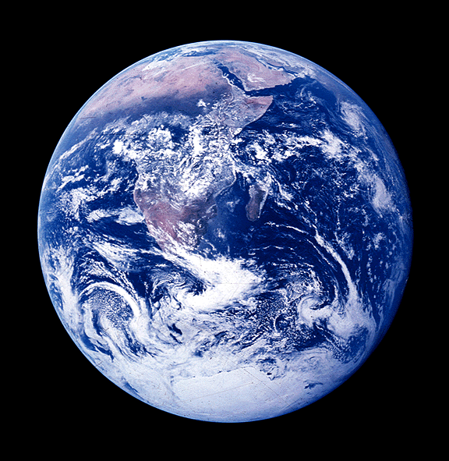

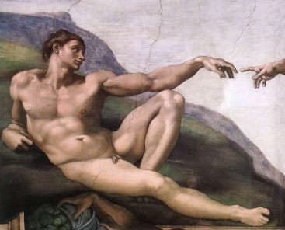


Beginning of Our World, Humanity
SOPHIA

Slide 17

Humanity has the True God within
SOPHIA

Slide 18
Observations
View we just saw feels DUALISTIC
Some Gnostics (Valentinians) taught that this creation of our material world by the Demiurge was an illusion deriving from our own misperceptions of the true God
Only reality = what derives from the true God (= MONISM)

Slide 19
Salvation?
The Christos comes to earth, manifest as a man (or resting upon a man = Jesus) to reveal the Light … and Gnosis.
The Demiurge’s archons / powers of darkness manipulate humans to kill Jesus.
The Christos returns to the Light / Pleroma.
His message = gnosis; light vs. darkness

Slide 20
Concluding Summary

Slide 21
Summary
Gnostics believe:
The “true God” and the divine Creator of our world are different beings.
Evil and suffering are the fault of this Creator (the Demiurge)
Humanity was created, but has a spark of the “true God” via Sophia

Slide 22
Summary
Salvation for humans is not deliverance from sin, but being awakened about their true divine nature.
Human destiny = return to the light
Return to the true source of human consciousness
Journey back into the cosmos

Slide 23
GNOSTIC GOSPELS

Slide 24
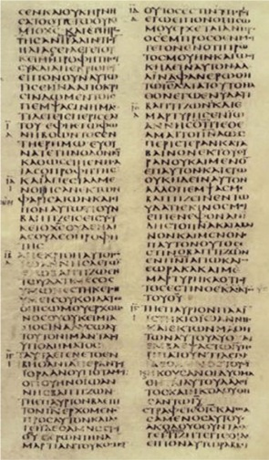
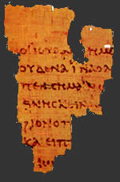
Manuscripts of the New Testament
vs.
The Gnostic Gospels from Nag Hammadi

Slide 25

Leigh Teabing, Grail expert character in The DaVinci Code:
“More than eighty gospels were considered for the New Testament, and yet only a relative few were chosen for inclusion – Matthew, Mark, Luke, and John among them.” (p. 231)
These texts . . . “are the earliest Christian records” (245) and the “unaltered gospels” (248).

Slide 26
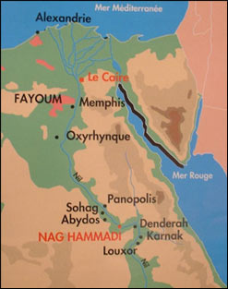
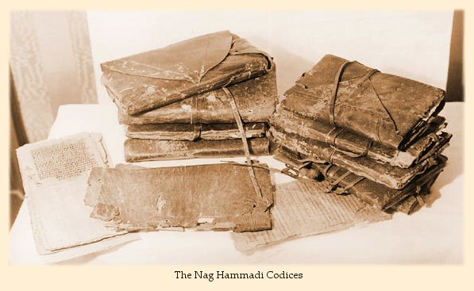
What are the
Nag Hammadi Documents?
The Nag Hammadi texts are a collection of thirteen ancient codices containing over fifty Gnostic texts. They were discovered by accident in upper Egypt in 1945.
Notes:
1. This is in upper Egypt.
2. Dr. Bart Ehrman, a New Testament scholar at the University of North Carolina at Chapel Hill, tells how the bedouin were initially reluctant to smash the sealed jar open because they feared that an evil genie might be inside. However, after thinking the matter over, they decided that there might also be gold inside! So the smashed the jar open and found…
3. Dr. Ehrman tells this story in a lecture series produced by The Teaching Company, Lost Christianities: Christian Scriptures and the Battles over Authentication, (Chantilly, Virginia: Parts 1 and 2, 2002).

Slide 27
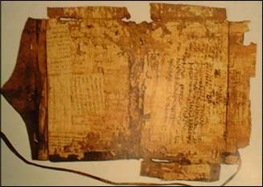
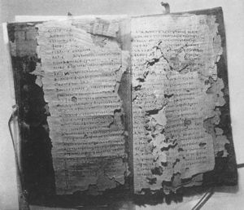
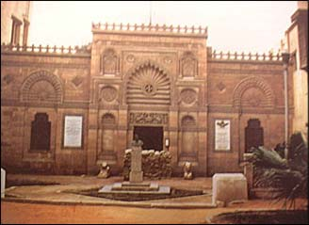
The books were quickly sold on the black market but were soon obtained by the Egyptian government.
They were taken to the Coptic Museum in Cairo, and another few years went by before scientists were made aware of their existence

Slide 28
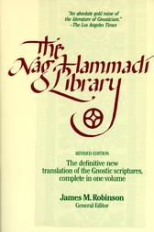
In 1966 at a conference in Italy devoted to Gnosticism and these new texts, James M. Robinson assembled a group of editors and translators to publish the Nag Hammadi codices in English, in collaboration with the Institute for Antiquity and Christianity in Claremont, California. Robinson oversaw the project. In the meantime, a facsimile edition in twelve volumes did appear between 1972 and 1977, with subsequent additions in 1979 and 1984 from publisher E.J. Brill in Leiden. The James M. Robinson translation was first published in 1977, with the name The Nag Hammadi Library in English.

Slide 29
The introductory material prefacing this translation notes:
“The library of fourth-century papyrus manuscripts consists of twelve codices plus eight leaves from a thirteenth and contains fifty-two separate tractates. Due to duplications there are forty-five separate titles. Because the majority of the library’s tractates derive from the Hellenistic sects now called gnostic, and survive in Coptic translations, it is characterized as the Coptic Gnostic Library.” (p. ix)

Slide 30
Do we have any other hard evidence that the New Testament Gospels are older than the oldest Nag Hammadi material?
What about the entire New Testament? Is that older than the oldest Nag Hammadi material?

Slide 31

NT Gospels, Acts
Presumed Greek original
Gnostic gospels
Coptic Gnostic Gospels (Nag Hammadi)
33 AD
50 – 80
100
200
300
325
400
500
NICEA
Why 50-80 AD for the New Testament Canonical Gospels? What is the Evidence?
Three Non-technical Points for Today:
1. The gospels prophesy the destruction of the Temple (occurred in AD 70) but never mention its fulfillment.
  Matthew 24, Mark 13, Luke 21
2. Luke never mentions the death of Paul and Peter in either his gospel or its sequel, the Book of Acts

Slide 32
Presumed Greek original
Gnostic gospels
NT Gospels, Acts
Coptic Gnostic Gospels (Nag Hammadi)
33 AD
50 – 80
100
200
300
325
400
500
NICEA
Didache (70-130) quotes Matthew extensively
Luke and John are both quoted in the Muratorian Fragment / Canon (170-180 AD)
Epistle of Pseudo-Barnabas (70-79) quotes Gospels of Matthew and Mark
Polycarp (69-155), a convert of the apostle John, quotes the book of Acts in his own Epistle to the Philippians (1:2); The Shepherd of Hermas (100-160) quotes Acts several times.
The Four NT Gospels and the Book of Acts

Slide 33
Presumed Greek original
Gnostic gospels
NT Gospels
Coptic Gnostic Gospels (Nag Hammadi)
33 AD
50 – 80
100
200
300
325
400
500
NICEA
1 Corinthians is cited in the Didache and the Shepherd of Hermas (100-160)
Romans is cited by Clement of Rome (95-97), Polycarp (69-155), and the Didache (70-130)
Galatians is cited by Polycarp, Diognetus
Ephesians and Colossians are cited by Polycarp, Clement, & Ignatius (50-117)
2 Corinthians is cited by Polycarp, the Shepherd of Hermas, and the Epistle of Diognetus (150)
Philippians is cited by Polycarp, Shepherd of Hermas, and Ignatius
The Epistles of Paul – Part 1

Slide 34
Presumed Greek original
Gnostic gospels
NT Gospels
Coptic Gnostic Gospels (Nag Hammadi)
33 AD
50 – 80
100
200
300
325
400
500
NICEA
1 Timothy and Titus are cited repeatedly by Clement; also cited in the Didache (1 Timothy) and the Shpeherd
1 and 2 Thessalonians is cited in the Shepherd of Hermas, the Didache, Polycarp, and Ignatius
Ignatius makes allusions to the personal letter to Philemon
The Epistles of Paul – Part 2

Slide 35
Presumed Greek original
Gnostic gospels
NT Gospels
Coptic Gnostic Gospels (Nag Hammadi)
33 AD
50 – 80
100
200
300
325
400
500
NICEA
The book of Hebrews is cited frequently by Clement and also by the Didache.
James is also cited by Clement and Ignatius
1 John is cited in the Shepherd of Hermas
1 and 2 Peter are cited by Clement
2 John is cited by Polycarp and in the Muratorian Fragment (170-180); 3 John and Jude are also cited by the Muratorian Fragment
Revelation is cited in the Didache, Shepherd of Hermas, and by Justin Martyr (160)
The General Epistles and Revelation

Slide 36
The fact is that the followers of Christ had chosen the 4 canonical Gospels as the true story of Jesus very early – before any of the surviving texts of the Coptic Gnostic Gospels, and likely before the Gnostic Gospels were composed (with the possible exception of the Gospel of Thomas).

Slide 37
Presumed Greek original
Gnostic gospels
NT Gospels
Coptic Gnostic Gospels (Nag Hammadi)
t
144
170
33 AD
50 – 80
100
160
200
300
325
400
500
NICEA
John dies
ca. 96 AD
Justin
Muratorian Fragment
Tatian
Marcion
Diatessaron
“Harmony of Four”
Describes 4 gospels, 13 epistles of Paul, Jude, 2 epistles of John
“Memoirs of the Apostles”
“the Gospel and the Apostle”
Notes:
Marcion: (1) rejected the authority of the OT for the church and so gave his followers a list of Holy Scripture comprising two divisions—The Gospel and The Apostle; (2) Ten letters of Paul (the nine to churches and one to Philemon); the former was an edition of the Gospel of Luke, edited according to Marcion’s theological predilections; (3) Despite the odd nature of this canon, it proves that the books within it were considered canonical well before Constantine
Justin: (1) reaction to Marcion - Against Marcion, which unfortunately has not survived; (2) speaks of the “memoirs of Peter,” possibly the Gospel of Mark; (3) speaks of the “memoirs of the apostles” which, he says, were called “gospels” and were read in church along with the compositions of the prophets

Slide 38
A word on Tatian’s Diatessaron:
“Justin’s disciple Tatian (c. 170 AD) produced a new edition of the fourfold Gospel by unstitching the sections of its four component parts and then rearranging them so as to form one continuous narrative. This edition, the Diatessaron (“harmony of four”), proved very popular, especially in Tatian’s native Assyria, where the Syriac-speaking church was most unwilling to abandon it at the beginning of the fifth century in favor of a new Syriac version of the four separate Gospels.”
“[The Gospel of Thomas] has been dated as early as A.D. 50–70 and as late as the end of the second century (note the wide divergence of dating opinion). But since parallels to its more explicitly Gnostic concepts and terminology date from the second century, it is probably no older than the end of the first century. The attribution of the Gospel to “Didymus Judas Thomas” (prologue) shows that it derives from the East Syrian Christian tradition, centered on Edessa.”
“NT Canon”; “Gospel of Thomas,” Dictionary of Jesus and the Gospels (IVP)

Slide 39
Mary Magdalene: Mrs. Jesus?

Slide 40
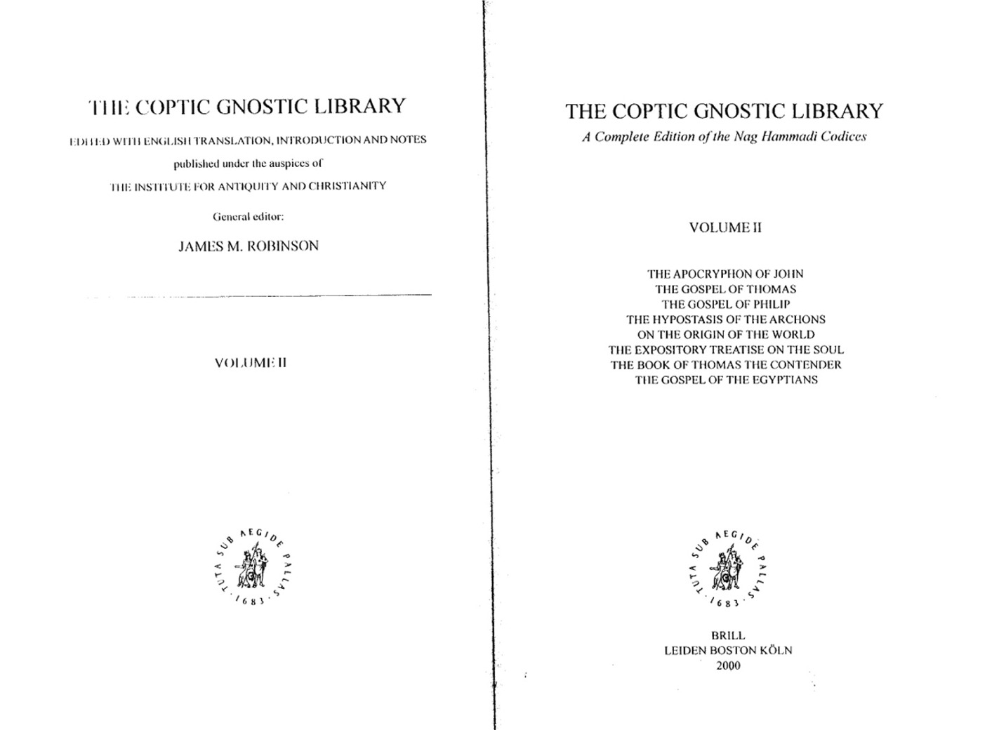

Slide 41
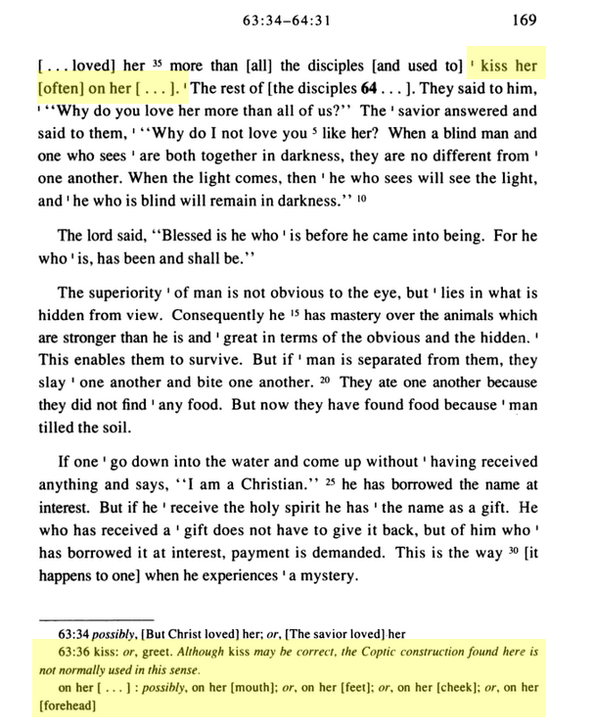

Slide 42
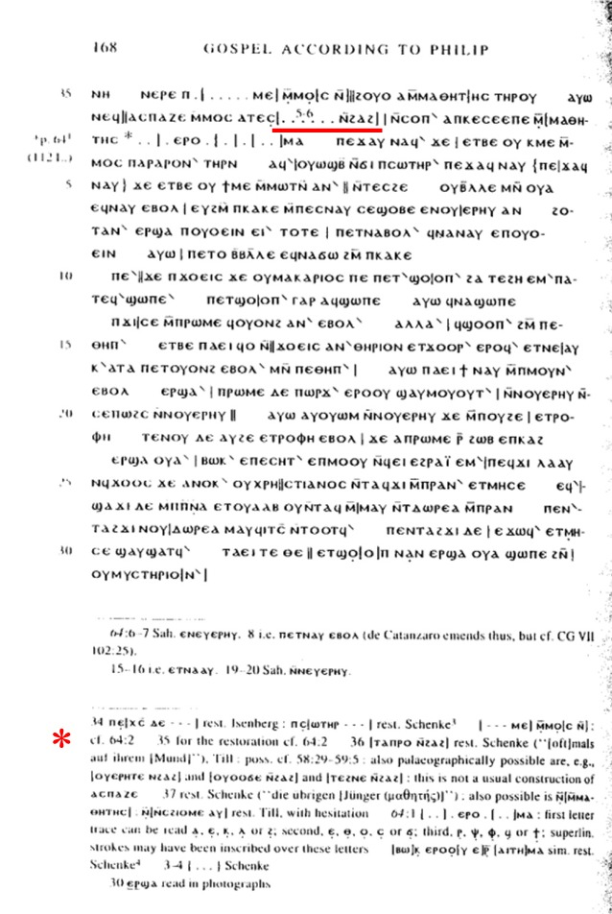

Slide 43
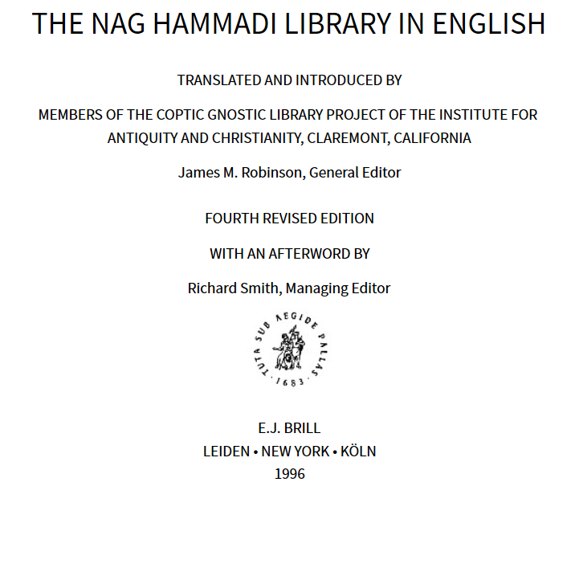
Jesus married?
NH Texts
Mary his wife?
NH Texts

Slide 44
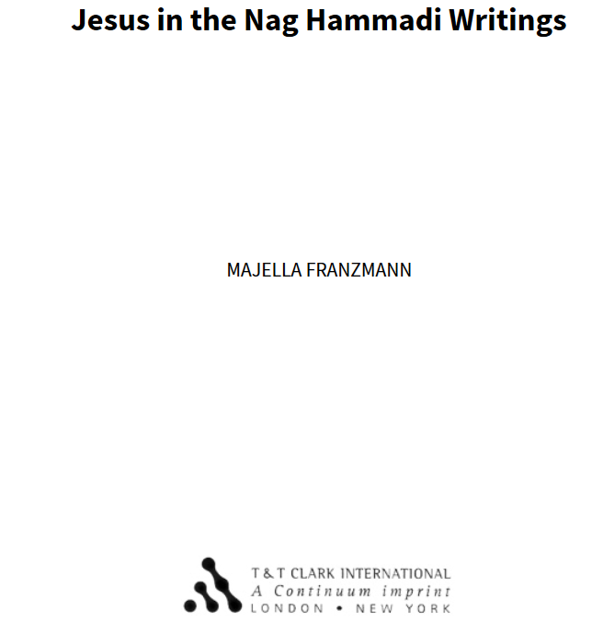
Jesus had a wife?
NH Texts

Slide 45
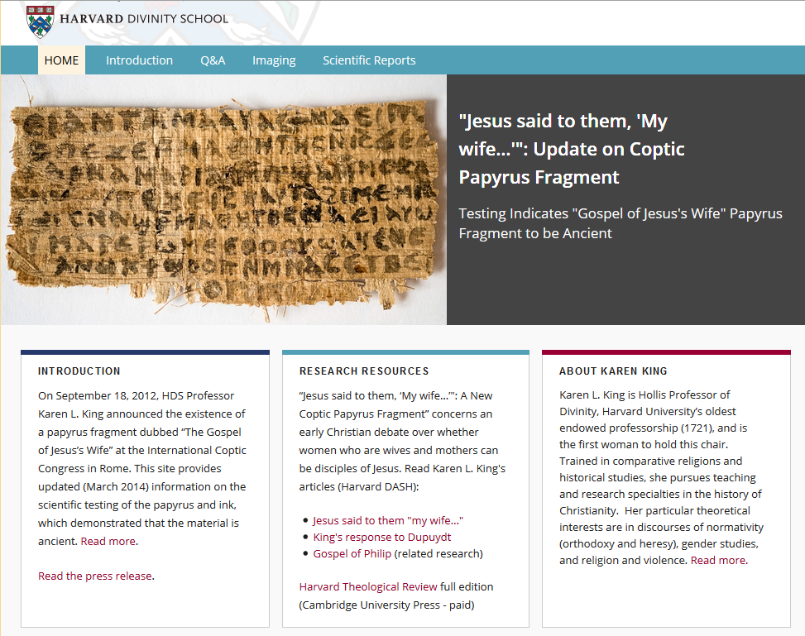

Slide 46
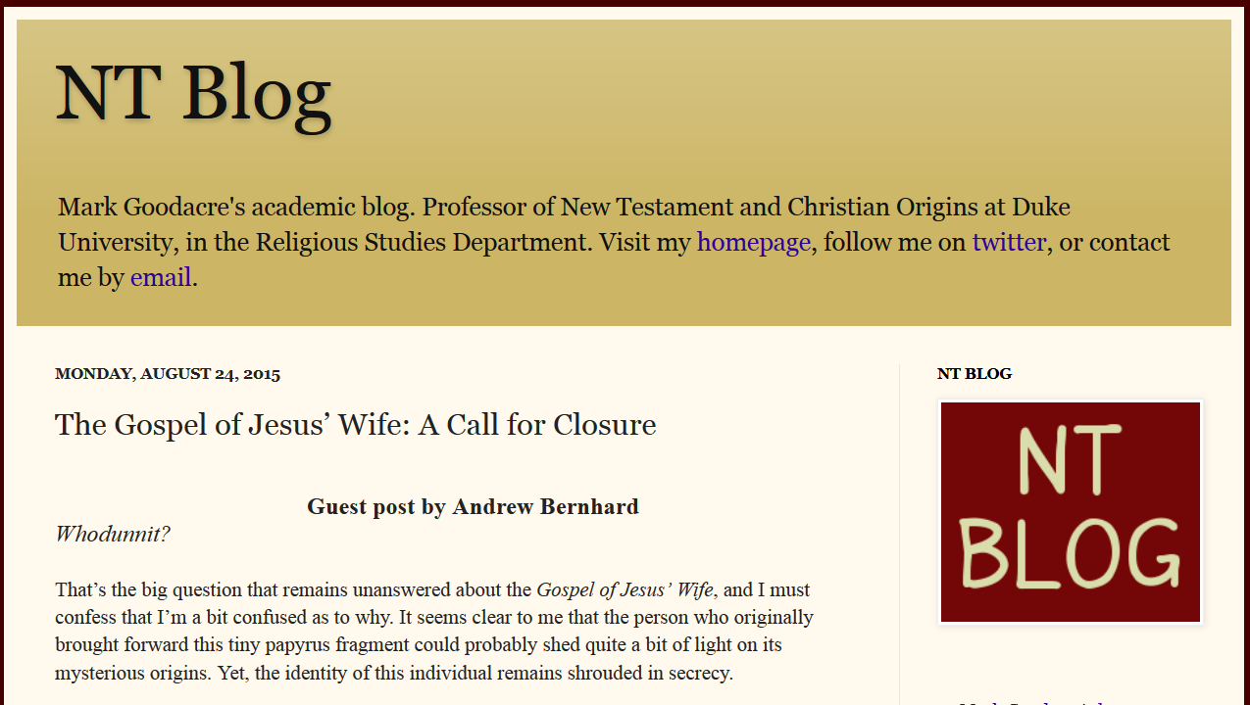

Slide 47
