Slide 1
Godhead in the
Old Testament
Israelite Monotheism,
High Christology, and
Judaism’s Two Powers in Heaven

Slide 2
Deut 6:4
﻿Hear, O Israel, the LORD our God,
the LORD is one.

Slide 3
John 1:18
﻿No one has ever seen God; ﻿the only God, who is at the Father’s side,
he has made him known.

Slide 4
How is it that a first century Jew, so committed to monotheism that he or she would choose death rather than worship the Roman emperor or a Roman god, could embrace Jesus of Nazareth as God in the flesh alongside the God of Israel?
Why was this not conceived of as a violation of the Shema and rejection of monotheism?

Slide 5
Translating the Shema
1. “The LORD is our God; the LORD is one.”
2. “The LORD our God, the LORD is one.”
3. “The Lord our God is one Lord.”
4. “The LORD is our God, the LORD alone.”
5. “Our one God is the LORD, the LORD.”

Slide 6
ODD PASSAGES

Slide 7
Genesis 19:24
YHWH rained upon Sodom and Gomorrah sulfurous fire from YHWH out of heaven.
Tanakh: The Holy Scriptures: A New Translation of the Holy Scriptures According to the Traditional Hebrew Text. Philadelphia: Jewish Publication Society (1997)

Slide 8
Genesis 19:24
YHWH rained upon Sodom and Gomorrah sulfurous fire from YHWH out of heaven.
Tanakh: The Holy Scriptures: A New Translation of the Holy Scriptures According to the Traditional Hebrew Text. Philadelphia: Jewish Publication Society (1997)

Slide 9
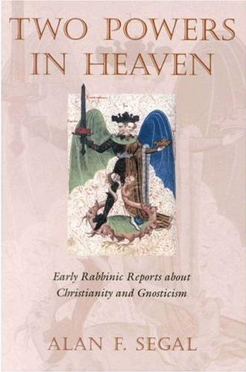
The idea of the 2nd power was not considered heretical until the 2nd century CE.
Segal, Two Powers in Heaven,
pp. x-xi (Introduction)

Slide 10
Points of Potential Confusion
Zoroastrianism?
Gnosticism?

Slide 11
The Two Powers

Slide 12
Exodus 15:3
יְהוָ֖ה אִ֣ישׁ מִלְחָמָ֑ה יְהוָ֖ה שְׁמֽוֹ׃
YHWH is a man of war;
YHWH is his name.

Slide 13
Daniel 7:9-13
As I looked on, thrones were set in place, And the Ancient of Days took His seat…

Slide 14
As I looked on, Thrones were set in place, And the Ancient of Days took His seat. His garment was like white snow, And the hair of His head was like lamb’s wool. His throne was tongues of flame; Its wheels were blazing fire. A river of fire streamed forth before Him; Thousands upon thousands served Him; Myriads upon myriads attended Him; The court sat and the books were opened. . . . One like a human being Came with the clouds of heaven; He reached the Ancient of Days And was presented to Him. Dominion, glory, and kingship were given to him;

Slide 15
Segal:
“[Daniel 7] describes a heavenly enthronement scene involving two divine manifestations, ‘the son of man’ and ‘the Ancient of Days’. . . . Not only does [Daniel 7:9ff.] allow the interpretation that God changes aspect, it may easily be describing two separate, divine figures. More than one throne is revealed and scripture describes two divine figures to fill them.”

Slide 16
Israel’s TWO Yahwehs

Slide 17
The ANGEL
& The NAME

Slide 18
Exodus 3
1 Now Moses, tending the flock of his father-in-law Jethro, the priest of Midian, drove the flock into the wilderness, and came to Horeb, the mountain of God. ﻿2 ﻿An angel of YHWH appeared to him in a blazing fire out of a bush. He gazed, and there was a bush all aflame, yet the bush was not consumed. ﻿3﻿ Moses said, “I must turn aside to look at this marvelous sight; why doesn’t the bush burn up?” ﻿4﻿ When YHWH saw that he had turned aside to look, God called to him out of the bush: “Moses! Moses!” He answered, “Here I am.”
﻿
﻿
Notes:
Go to ESV Reverse Interlinear at Joshua 5:13, search on TEXT form for “drawn”

Slide 19
Exodus 23
﻿20 ﻿ I am sending an angel before you to guard you on the way and to bring you to the place that I have made ready. ﻿21﻿ Pay heed to him and obey him. Do not defy him, for he will not pardon your offenses, since My Name is in him; ﻿22﻿ but if you obey him and do all that I say, I will be an enemy to your enemies and a foe to your foes.
﻿
﻿
Notes:
Go to ESV Reverse Interlinear at Joshua 5:13, search on TEXT form for “drawn”

Slide 20
Deuteronomy 12
⁴ Do not worship the Lord your God in like manner, ⁵ but look only to the site that the Lord your God will choose amidst all your tribes as His habitation, to establish His name there. There you are to go, ⁶ and there you are to bring your burnt offerings and other sacrifices, your tithes and contributions, your votive and freewill offerings, and the firstlings of your herds and flocks . . . ¹¹ you must bring everything that I command you to the site where the Lord your God will choose to establish His name . . .

Slide 21
Psalm 20:1, 7
May the Lord answer you in the day of trouble!
May the name of the God of Jacob protect you!
Some trust in chariots and some in horses, but we trust in the name of the Lord our God.

Slide 22
Isaiah 30:27
Behold the Name of the Lord
Comes from afar
In blazing wrath,
With a heavy burden—
His lips full of fury,
His tongue like devouring fire,

Slide 23
Exodus 23
﻿20 ﻿ I am sending an angel before you to guard you on the way and to bring you to the place that I have made ready. ﻿21﻿ Pay heed to him and obey him. Do not defy him, for he will not pardon your offenses, since My Name is in him; ﻿22﻿ but if you obey him and do all that I say, I will be an enemy to your enemies and a foe to your foes.
﻿
﻿
Notes:
Go to ESV Reverse Interlinear at Joshua 5:13, search on TEXT form for “drawn”

Slide 24
Deuteronomy 4:35-37
³⁵ To you it was shown, ﻿that you might know that the Lord is God; ﻿there is no other besides him. ³⁶ ﻿Out of heaven he let you hear his voice, that he might discipline you. And on earth he let you see his great fire, and ﻿you heard his words out of the midst of the fire. ³⁷ And because ﻿he loved your fathers and chose their offspring after them﻿ and brought you out of Egypt ﻿with his own presence (panim) by his great power…
﻿
﻿
Notes:
Go to ESV Reverse Interlinear at Joshua 5:13, search on TEXT form for “drawn”

Slide 25
Judges 2
﻿1 The angel of YHWH came up from Gilgal to Bochim and said, “I brought you up from Egypt and I took you into the land which I had promised on oath to your fathers. And I said, ‘I will never break My covenant with you. ﻿2﻿ And you, for your part, must make no covenant with the inhabitants of this land; you must tear down their altars.’ But you have not obeyed Me—look what you have done! ﻿3﻿ Therefore, I have resolved not to drive them out before you; they shall become your oppressors,﻿ and their gods shall be a snare to you.” ﻿4﻿ As the angel of YHWH spoke these words to all the Israelites, the people broke into weeping. ﻿
﻿
﻿
Notes:
Go to ESV Reverse Interlinear at Joshua 5:13, search on TEXT form for “drawn”

Slide 26
Genesis 31:10-13
¹⁰ In the breeding season of the flock I lifted up my eyes and saw in a dream that the goats that mated with the flock were striped, spotted, and mottled. ¹¹ Then the angel of God said to me in the dream, ‘Jacob,’ and I said, ‘Here I am!’ ¹² And he said, ‘Lift up your eyes and see, all the goats that mate with the flock are striped, spotted, and mottled, for I have seen all that Laban is doing to you.
¹³ I am the God of Bethel, where you anointed a pillar and made a vow to me. Now arise, go out from this land and return to the land of your kindred.’ ”

Slide 27
Genesis 48:14-16
¹⁴ But Israel [i.e., Jacob] stretched out his right hand and laid it on Ephraim’s head, though he was the younger, and his left hand on Manasseh’s head—thus crossing his hands—although Manasseh was the first-born. ¹⁵ And he blessed Joseph, saying:
“The God in whose ways my fathers Abraham and Isaac walked;
The God who has been my shepherd from my birth to this day—
The Angel who has redeemed me from all harm—
May he bless these lads.”

Slide 28
The Angel =
The Name =
The Presence of YHWH =
YHWH
The Angel and Yahweh are at times co-identified and yet distinguished by passages …
BUT do they ever appear together?

Slide 29
Judges 6
﻿11﻿ An angel of YHWH came and sat under the terebinth at Ophrah, which belonged to Joash the Abiezrite. His son Gideon was then beating out wheat inside a winepress in order to keep it safe from the Midianites. ﻿12﻿ The angel of YHWH appeared to him and said to him, “YHWH is with you, valiant warrior!” ﻿13﻿ Gideon said to him, “Please, my lord, if YHWH is with us, why has all this befallen us?

Slide 30
¹⁴ And YHWH﻿ turned to him and said, “Go in this might of yours and save Israel from the hand of Midian; do not I send you?” ¹⁵ And he said to him, “Please, Lord, how can I save Israel? Behold, my clan is the weakest in Manasseh, and I am the least in my father’s house.” ¹⁶ And YHWH said to him, “But I will be with you, and you shall strike the Midianites as one man.” ¹⁷ And he [Gideon] said to him [the Angel / YHWH?], “If now I have found favor in your eyes, then show me a sign that it is you who speaks with me. ¹⁸ Please do not depart from here until I come to you and bring out my present and set it before you.” And he said, “I will stay till you return.”

Slide 31
¹⁹ So Gideon . . . brought them to him under the terebinth and presented them. ²⁰ And the angel of God said to him, “Take the meat and the unleavened cakes, and put them on this rock, and pour the broth over them.” And he did so. ²¹ Then the angel of YHWH reached out the tip of the staff that was in his hand and touched the meat and the unleavened cakes. And fire sprang up from the rock and consumed the flesh and the unleavened cakes. And the angel of YHWH vanished from his sight. ²² Then Gideon perceived that he was the angel of YHWH. And Gideon said, “Alas, O Lord God! For now I have seen the angel of the Lord face to face.” ²³ But YHWH said to him, “Peace be to you. Do not fear; you shall not die.”

Slide 32
The WORD

Slide 33
Genesis 15
¹ After these things the word of the Lord came to Abram in a vision, “Do not be afraid, Abram, I am your shield; your reward shall be very great.”

Slide 34
1 Samuel 3
¹ Now the young man Samuel was ministering to the Lord (YHWH) under Eli. And the word of the Lord was rare in those days; there was no frequent vision . . .
^{﻿7﻿}Now Samuel had not yet experienced the Lord; the word of the Lord had not yet been revealed to him. ⁸ And the Lord called Samuel again the third time . . .

Slide 35
¹⁰ And the LORD (YHWH) came and stood, calling as at other times, “Samuel! Samuel!” And Samuel said, “Speak, for your servant hears.”
¹⁹ And Samuel grew, and the LORD (YHWH) was with him and let none of his words fall to the ground. ²⁰ And all Israel from Dan to Beersheba knew that Samuel was established as a prophet of the Lord. ²¹ And the LORD (YHWH) appeared again at Shiloh, the LORD (YHWH) revealed himself to Samuel at Shiloh by/as the word of the Lord.

Slide 36
Jeremiah 1
⁴ Now the word of the Lord came to me saying, ⁵ “Before I formed you in the womb I knew you. . . .” ⁶ Then I said, “Ah, Lord God (YHWH elohim)! Truly I do not know how to speak, for I am only a boy.” ⁷ But the LORD (YHWH) said to me, “Do not say, ‘I am only a boy’; for you shall go to all to whom I send you . . . ⁹ Then the LORD (YHWH) put out his hand and touched my mouth; and the LORD (YHWH) said to me, “Now I have put my words in your mouth.

Slide 37
The “Cloud-Rider”

Slide 38
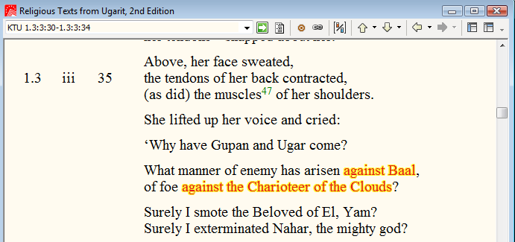
“He Who Rides the Clouds”

Slide 39
Deuteronomy 33
²⁶ “There is none like God, O Jeshurun, who rides through the heavens to your help, through the skies in his majesty.

Slide 40
Psalm 68
³² O kingdoms of the earth, sing to God; sing praises to the LORD (YHWH) , Selah ³³ to him who rides in the heavens, the ancient heavens; behold, he sends out his voice, his mighty voice. ³⁴ Ascribe power to God, whose majesty is over Israel, and whose power is in the skies.

Slide 41
Psalm 104
1 Bless the Lord, O my soul! O LORD (YHWH) my God, you are very great! You are clothed with splendor and majesty, ² covering yourself with light as with a garments stretching out the heavens like a tent. ³ He lays the beams of his chambers on the waters; he makes the clouds his chariot; he rides on the wings of the wind.

Slide 42
Isaiah 19
An oracle concerning Egypt.
Behold, the Lord is riding on a swift cloud and comes to Egypt; and the idols of Egypt will tremble at his presence, and the heart of the Egyptians will melt within them.

Slide 43
Jesus Against this Backdrop

Slide 44
The Word
John 1:1-3, 14, 18
¹ In the beginning was the Word, and the Word was with God, and the Word was God. ² He was in the beginning with God. ³ All things were made through him, and without him was not any thing made that was made . . . ¹⁴ And the Word became flesh and dwelt among us, and we have seen his glory, glory as of the only Son from the Father, full of grace and truth . . . ¹⁸ No one has ever seen God; the only God,﻿ who is at the Father’s side,﻿ he has made him known.

Slide 45
The Angel
Jude 5
⁵ Now I want to remind you, although you once fully knew it, that Jesus, who saved a people out of the land of Egypt, afterward destroyed those who did not believe.
Exodus 23:20 - I am sending an angel before you to guard you on the way and to bring you to the place that I have made ready.
Judges 2:1 - Now the angel of the Lord went up from Gilgal to Bochim. And he said, “I brought you up from Egypt and brought you into the land that I swore to give to your fathers.

Slide 46
The Name
John 17
⁶ ﻿“I have manifested your name to the people ﻿whom you gave me out of the world. ﻿Yours they were, and you gave them to me, and they have kept your word.
¹² ﻿While I was with them, I kept them in/by your name, which you have given me.
²⁶ ﻿I made known to them your name, and I will continue to make it known, that the love ﻿with which you have loved me may be in them, and ﻿I in them.”

Slide 47
Rider on the Clouds
¹³ I saw in the night visions, and behold, upon the clouds of heaven there came one like a son of man, and he came to the Ancient of Days and was presented before him.

Slide 48
Matthew 26
⁵⁷ Then those who had seized Jesus led him to Caiaphas the high priest, where the scribes and the elders had gathered. … ⁶² And the high priest stood up and said, “Have you no answer to make? What is it that these men testify against you?” ⁶³ But Jesus remained silent. And the high priest said to him, “I adjure you by the living God, tell us if you are the Christ, the Son of God.” ⁶⁴ Jesus said to him, “You have said so. But I tell you, from now on you will see the Son of Man seated at the right hand of Power and coming on the clouds of heaven.” ⁶⁵ Then the high priest tore his robes and said, “He has uttered blasphemy. What further witnesses do we need? You have now heard his blasphemy.

Slide 49
Trinity in the OT?

Slide 50
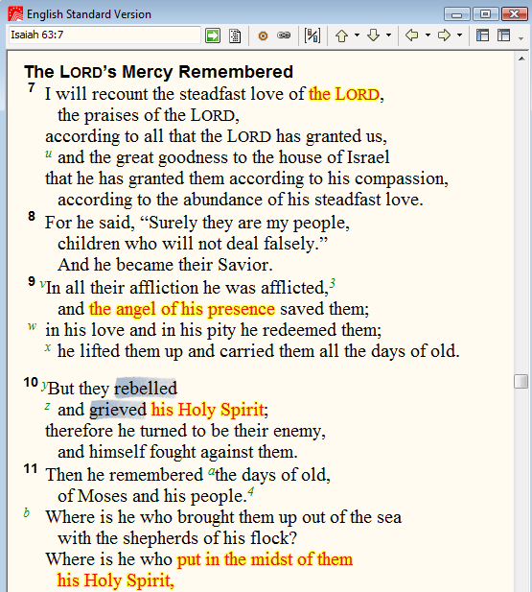
Psalm 78
⁴⁰ How often they rebelled against him in the wilderness and grieved him in the desert!
⁴¹ They tested God again and again and provoked the Holy One of Israel.

Slide 51
Ezekiel 8
2 Then I looked, and behold, a form that had the appearance of a man. Below what appeared to be his waist was fire, and above his waist was something like the appearance of brightness, like gleaming metal. 3 He put out the form of a hand and took me by a lock of my head, and the Spirit lifted me up between earth and heaven and brought me in visions of God to Jerusalem, to the entrance of the gateway of the inner court that faces north, where was the seat of the image of jealousy, which provokes to jealousy. 4 And behold, the glory of the God of Israel was there, like the vision that I saw in the valley.
5 Then he said to me, “Son of man, lift up your eyes now toward the north.” So I lifted up my eyes toward the north, and behold, north of the altar gate, in the entrance, was this image of jealousy. 6 And he said to me, “Son of man, do you see what they are doing, the great abominations that the house of Israel are committing here, to drive me far from my sanctuary? But you will see still greater abominations.”
Ezekiel elsewhere recognizes his guide as Yahweh and addresses him as “Lord God” (Ezek 9:8;11:13)

