Slide 1
Science fiction & cinematic theology
Pop Culture as High Priestly Mediator of the
Post-Christian Religious Worldview

Slide 2
Post-Christian Theology
Who or What is/are the Deity/Deities?
What is the Salvation of humankind?
How is this theology communicated?

Slide 3
Who or What is/are the Deity/Deities?

Slide 4

Who or What is/are the Deity/Deities?
Nature
  Monistic Paganism

Slide 5
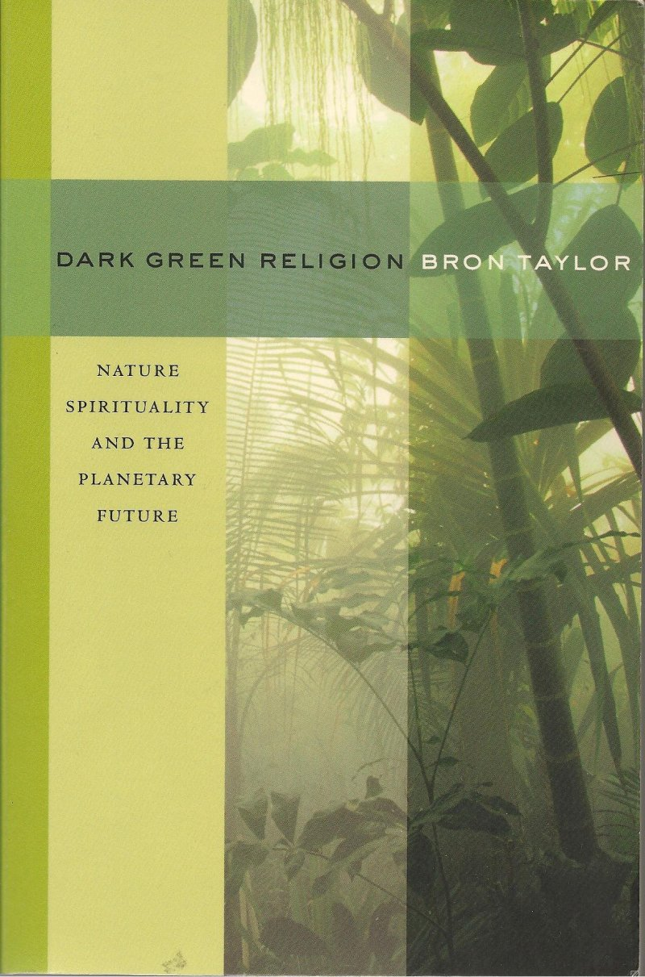
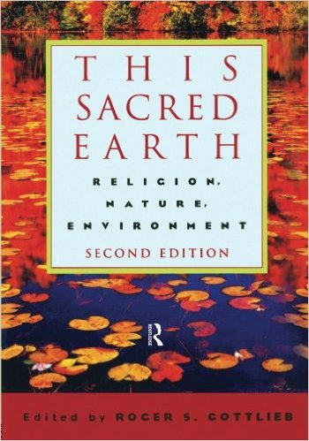

Slide 6
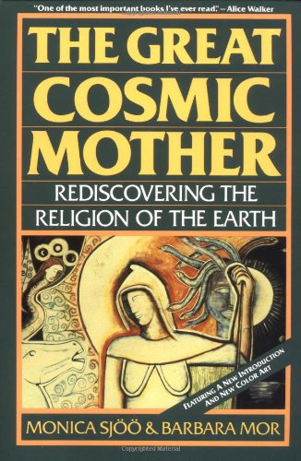


Slide 7
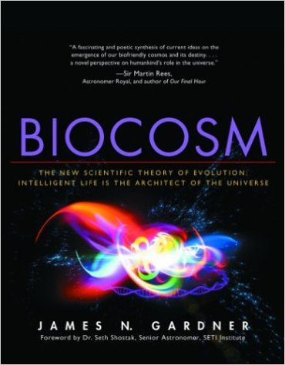
Who or What is/are the Deity/Deities?
Nature
  Monistic Paganism
  Monistic Biocosm
Gardner is a graduate of Yale College and the Yale Law School. He studied philosophy and theoretical biology. He has published peer-reviewed articles published in scholarly journals like Complexity and the Journal of the British Interplanetary Society.

Slide 8
“Science writer and amateur cosmologist Gardner proposes a startling theory: that a pre-existing superintelligent race that inhabited a ‘mother universe’ created this one and tweaked the physical laws in its baby universe to ensure the continuity of intelligent life and of the cosmos itself.”

Slide 9
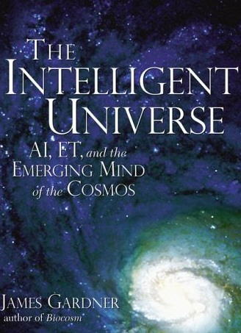
Who or What is/are the Deity/Deities?
Nature
  Monistic Paganism
  Monistic Biocosm

Slide 10
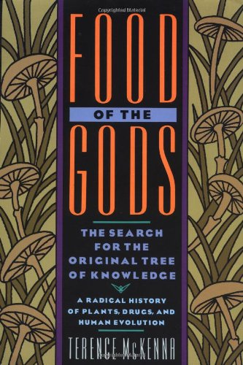
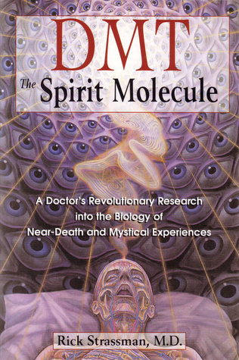
Who or What is/are the Deity/Deities?
Ourselves
  Intuition / Inner Space

Slide 11
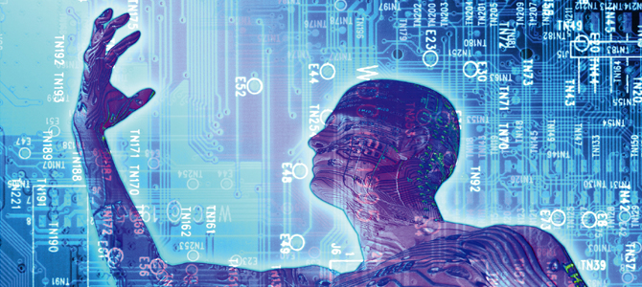
Who or What is/are the Deity/Deities?
Ourselves
  Intuition / Inner Space
  Technological transhumanism

Slide 12
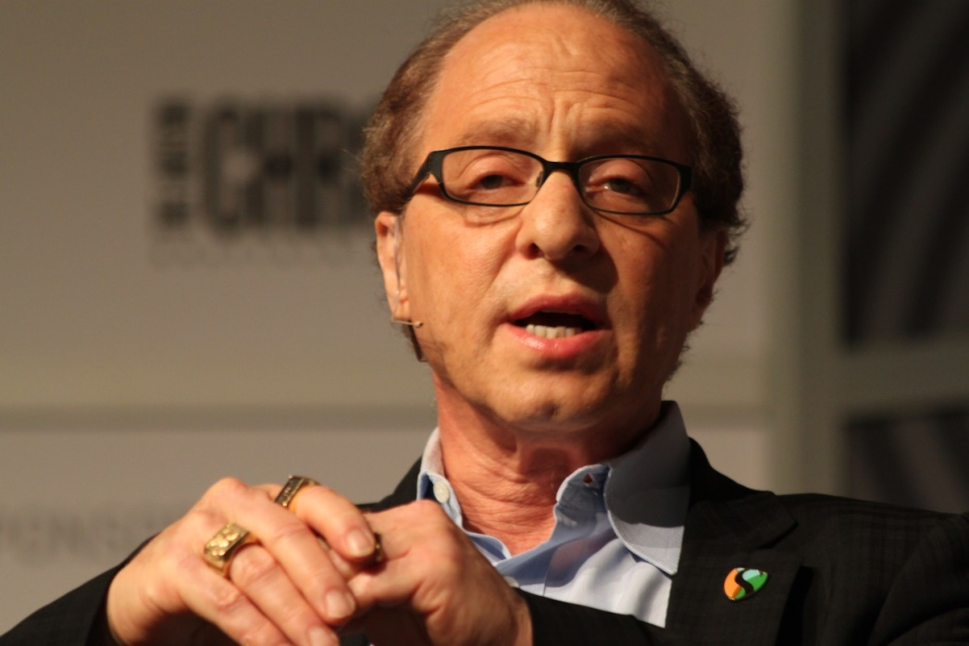
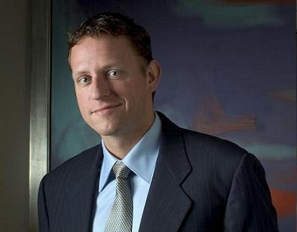
Who or What is/are the Deity/Deities?
Ourselves
  Intuition / Inner Space
  Technological transhumanism

Slide 13
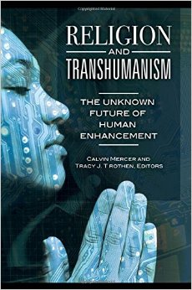
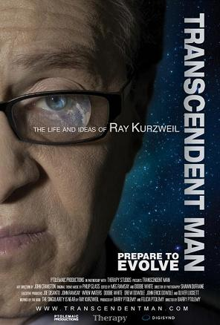
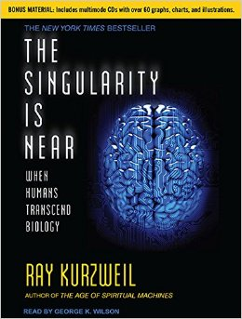

Slide 14
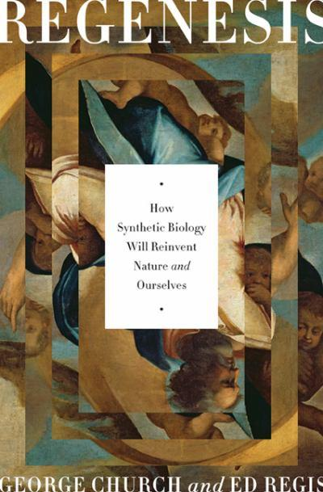
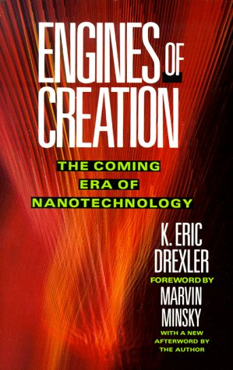

Slide 15
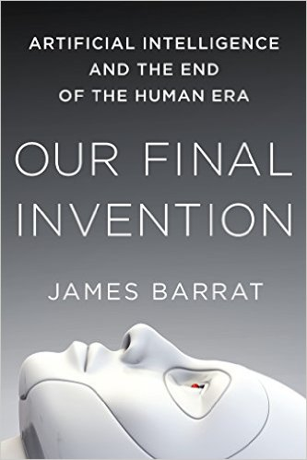
Who or What is/are the Deity/Deities?
Transcendent Other
  Artificial Intelligence

Slide 16
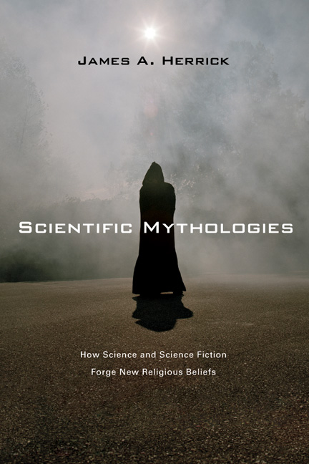
Who or What is/are the Deity/Deities?
Transcendent Other
  Artificial Intelligence
  Extraterrestrial

Slide 17
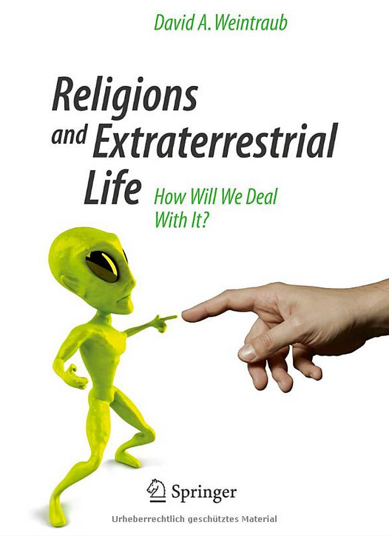
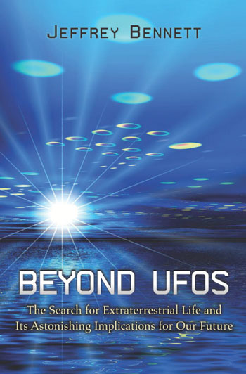
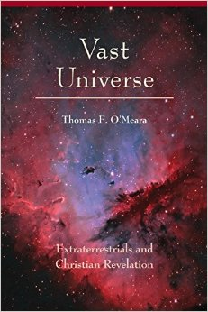

Slide 18
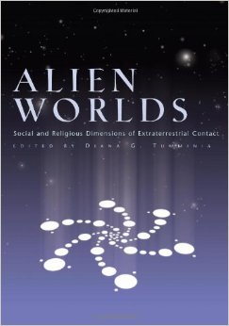
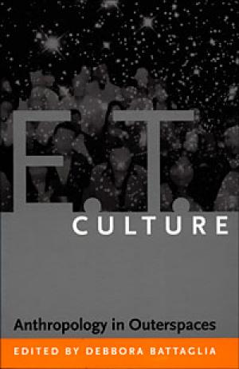
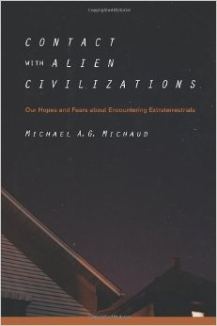
Michaud

Slide 19
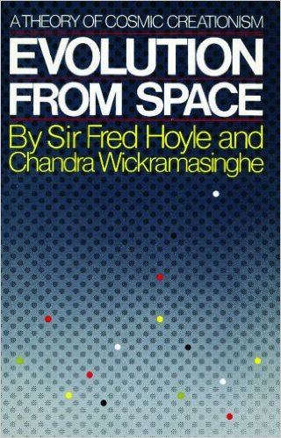
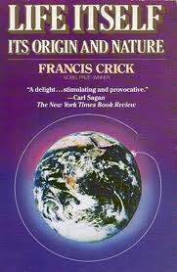
Panspermia

Slide 20
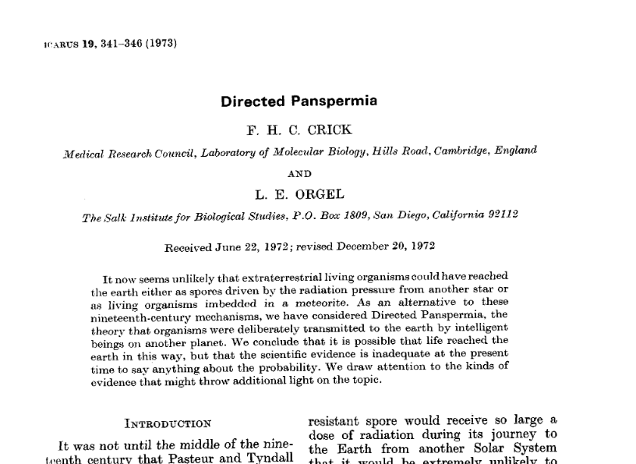

Slide 21
The Cosmist Manifesto (B. Goertzel)
Humans will merge with technology, to a rapidly increasing extent. This is a new phase of the evolution of our species . . .
Humans will develop sentient AI and mind uploading technology. Mind uploading technology will permit an indefinite lifespan to those who choose to leave biology behind . . .
Humans will spread to the stars and roam the universe. We will meet and merge with other species out there . . .
Humans will develop interoperable synthetic realities (virtual worlds) able to support sentience. Some uploads will choose to live in virtual worlds. The divide between physical and synthetic realities will blur, then disappear.

Slide 22
The Cosmist Manifesto (B. Goertzel)
Humans will develop spacetime engineering and scientific "future magic" much beyond our current understanding and imagination.
Spacetime engineering and future magic will permit achieving, by scientific means, most of the promises of religions -- and many amazing things that no human religion ever dreamed. Eventually we will be able to resurrect the dead by "copying them to the future.“
Intelligent life will become the main factor in the evolution of the cosmos, and steer it toward an intended path.

Slide 23
The Cosmist Manifesto (B. Goertzel)
Technological advances will reduce material scarcity drastically, so that abundances of wealth, growth and experience will be available to all minds who so desire . . .
New ethical systems will emerge, based on principles including the spread of joy, growth and freedom through the universe, as well as new principles we cannot yet imagine.
All these changes will fundamentally improve the subjective and social experience of humans and our creations and successors, leading to states of individual and shared awareness possessing depth, breadth and wonder far beyond that accessible to "legacy humans.”

Slide 24
Post-Christian Theology
Who or What is/are the Deity/Deities?
What is the Salvation of humankind?

Slide 25
What is the Salvation of humankind?
Answer: Cosmist Manifesto …
Technological advances will reduce material scarcity drastically, so that abundances of wealth, growth and experience will be available to all minds who so desire . . .
The earth will save us …

Slide 26
What is the Salvation of humankind?
Answer: Cosmist Manifesto …
Humans will develop sentient AI and mind uploading technology. Mind uploading technology will permit an indefinite lifespan to those who choose to leave biology behind . . .
We will save ourselves …

Slide 27
What is the Salvation of humankind?
Answer: Cosmist Manifesto …
Spacetime engineering and future magic will permit achieving, by scientific means, most of the promises of religions . . . Eventually we will be able to resurrect the dead by "copying them to the future.”

Slide 28
What is the Salvation of humankind?
Answer: Cosmist Manifesto …
Spacetime engineering and future magic will permit achieving, by scientific means, most of the promises of religions . . . Eventually we will be able to resurrect the dead by "copying them to the future.”

Slide 29
What is the Salvation of humankind?
  Humanity is not lost in sin, but in the primitive stages of biological, spiritual, and social evolution.
  Humanity in its present condition is a threat to itself; it must be saved by a greater intelligence.

Slide 30
Post-Christian Theology Summary
Monism
  Intelligent Design without a personal God
  ET gods acceptable
Salvation by knowledge
  Nature
  Science
  Technology
Human Divinity

Slide 31
Post-Christian Theology Summary
Space is now heaven, purged of religion
Extraterrestrials are the new god(s)
The new salvation is either:
  ET contact
  Evolution beyond humanity like ET gods
Result = new Edenic utopia
  No scarcity, disease, or death

Slide 32
Post-Christian Theology
Who or What is/are the Deity/Deities?
What is the Salvation of humankind?
How is this theology communicated?

Slide 33
How communicated?
“[T]here is today—in a time when old beliefs are withering—a kind of philosophical hunger, a need to know who we are and how we got here. There is an ongoing search, often unconscious, for a cosmic perspective for humanity.”
Carl Sagan, The Cosmic Connection (1973), p. 59

Slide 34
How communicated?
“We need a new religion.”
Ray Kurzweil, The Singularity is Near: When
Humans Transcend Biology (2005), p. 374

Slide 35
How communicated?
“[There is] an emerging canon of transcendent stories that provides meaning to our lives . . . the mythmaking work of two powerful engines of cultural influence—speculative science . . . And the works of science fiction . . .

Slide 36
How communicated?
“. . . [presented to us as] a much-needed alternative to more traditional perspectives on God, people, and the destiny of the human race, an alternative that will open a spiritual pathway into the increasingly technological future.”
James Herrick, Scientific Mythologies: How Science and
Science Fiction Forge New Religious Beliefs (2008), p. 13

Slide 37
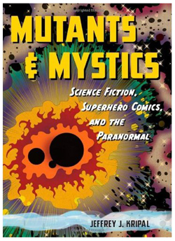
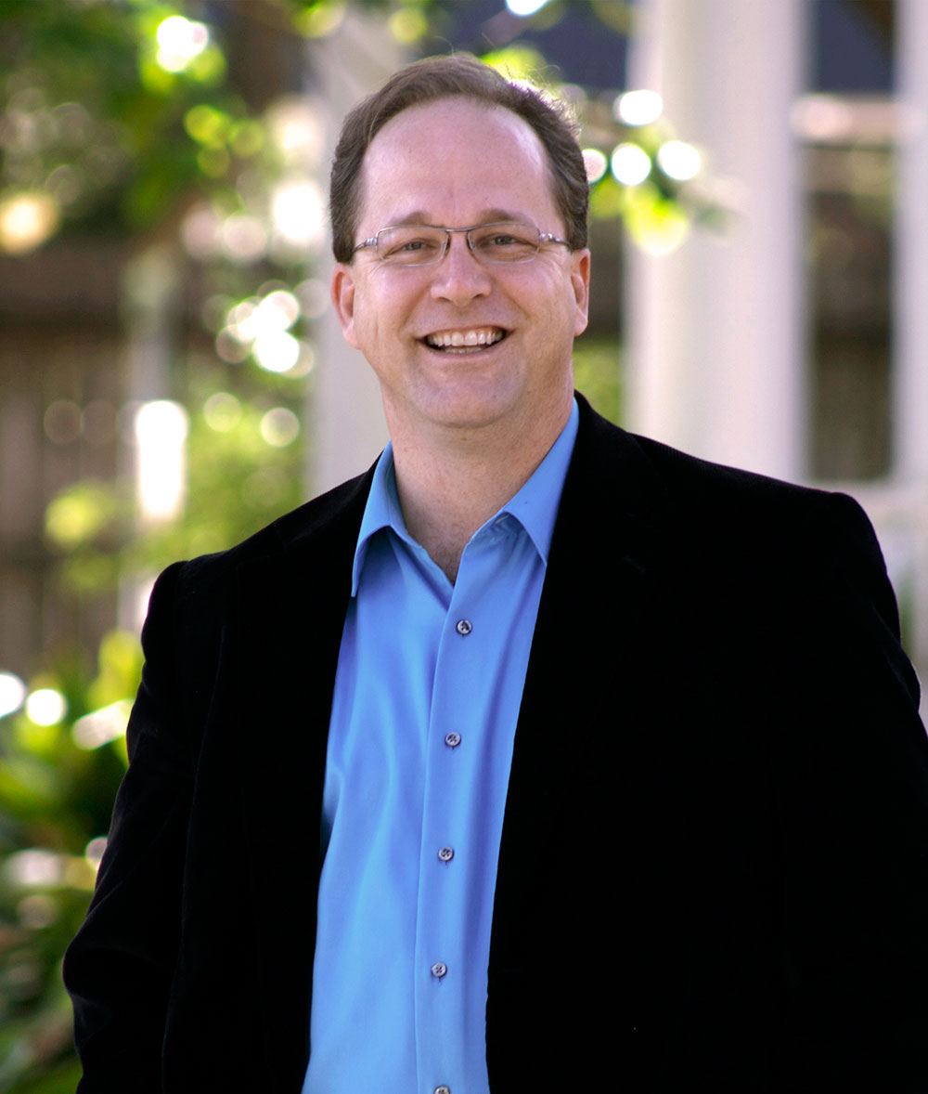
Academy
Ph.D. from the University of Chicago Divinity School in 1993. He currently holds the J. Newton Rayzor Chair in Philosophy and Religious Thought in the Department of Religious Studies at Rice University

Slide 38
How communicated?
Kripal identifies a 'Super-Story' – 'a modern living mythology' - that underlies and shapes not only SF and superhero literature but also contemporary American popular culture, in particular beliefs concerning alien contact and humankind's place in the cosmic scheme of things, a story made up of seven mythical themes or 'mythemes', to each of which he devotes a chapter. .

Slide 39
How communicated?
. . . Kripal shows how American SF and fantasy fiction owes less to science than it does to nineteenth-century esoteric traditions – themselves, of course, developments of earlier occult systems – in particular Theosophy and Rosicrucianism . . .
Kripal also points out that the first explicit claim of extraterrestrial intervention in human evolution is found in Madame Blavatsky's writings, in which advanced spiritual beings from Venus helped breed the Atlantean 'root race' from the Lemurian.

Slide 40

How communicated?
French scientist and science fiction writer Bernard de Fontenelle (1657-1757): Conversations on the Plurality of Worlds (1686):
  hostile to Christianity, promoted polygenism

Slide 41
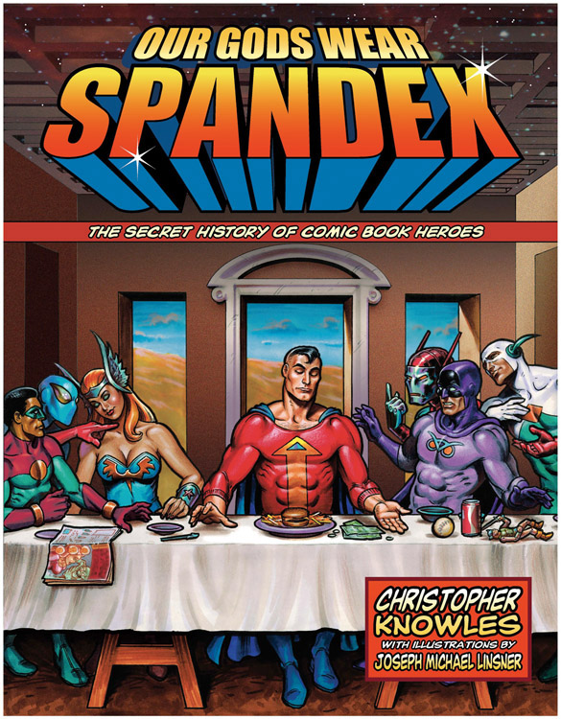
Pop Culture
Frequently Utilizes:
Extraterrestrials
  The gods of old (archons)
Super Heroes
  Part human, part “non-human” (evolving; mutants; technological augmentation)
  Divine in human form

Slide 42
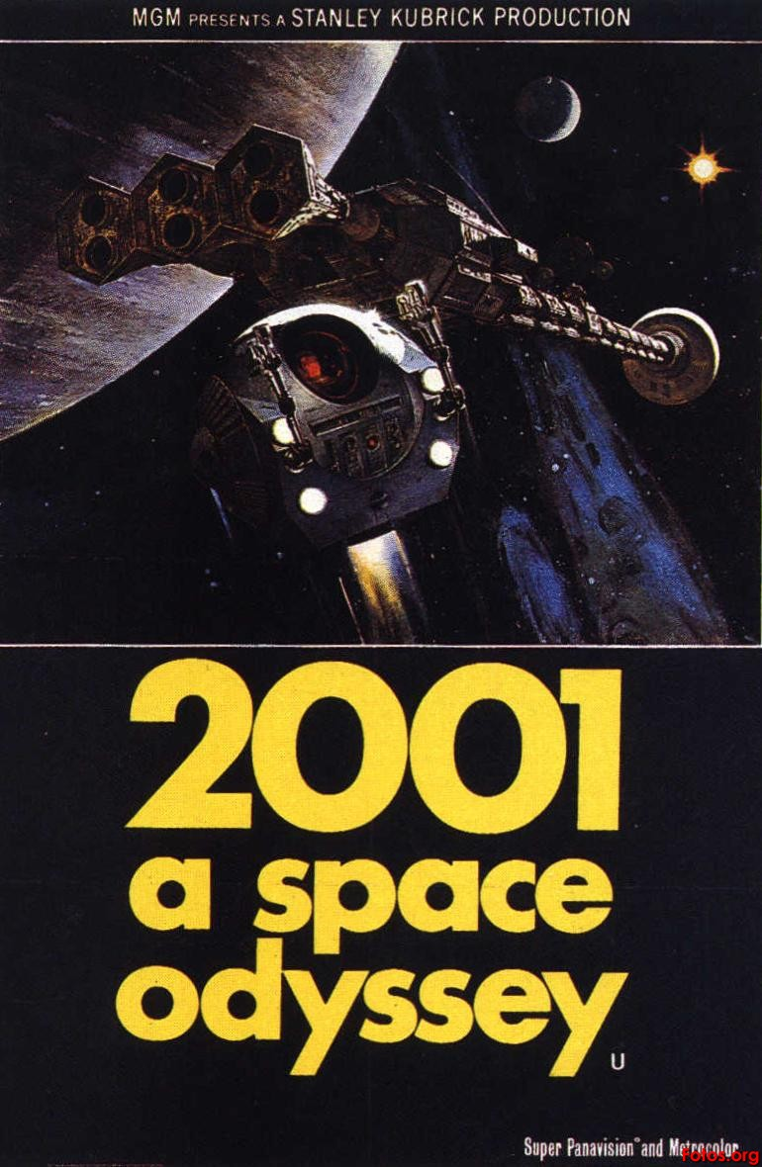
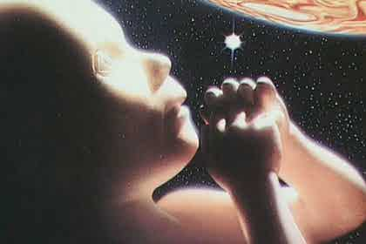

Slide 43
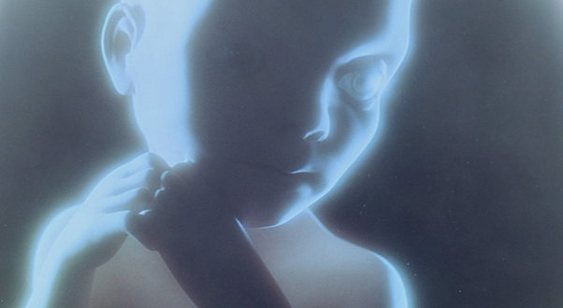
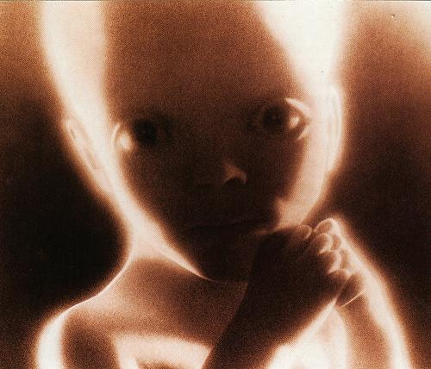
“Now they were Lords of the Galaxy, and could rove at will among the stars.”

Slide 44


Slide 45


Slide 46


Slide 47


Slide 48


Slide 49

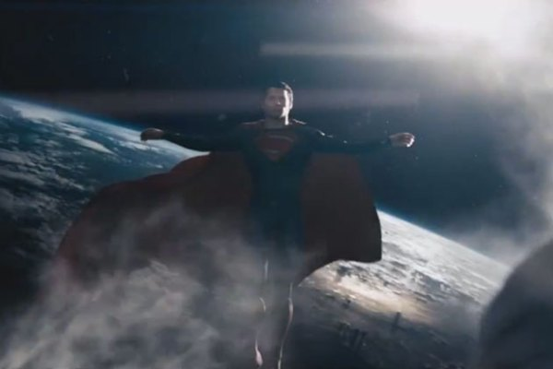

Slide 50
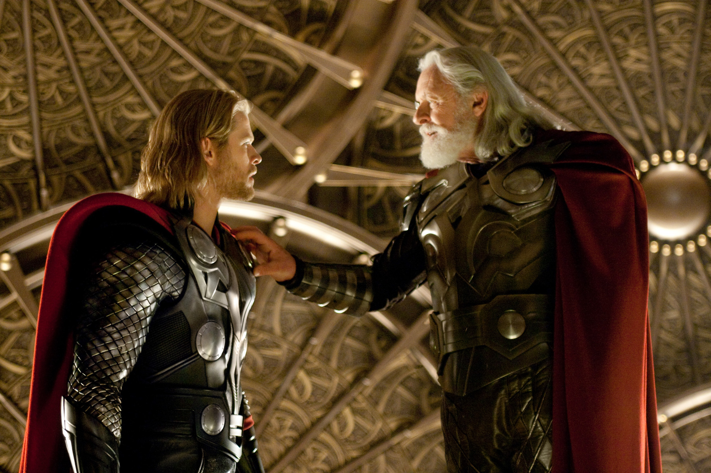

Slide 51
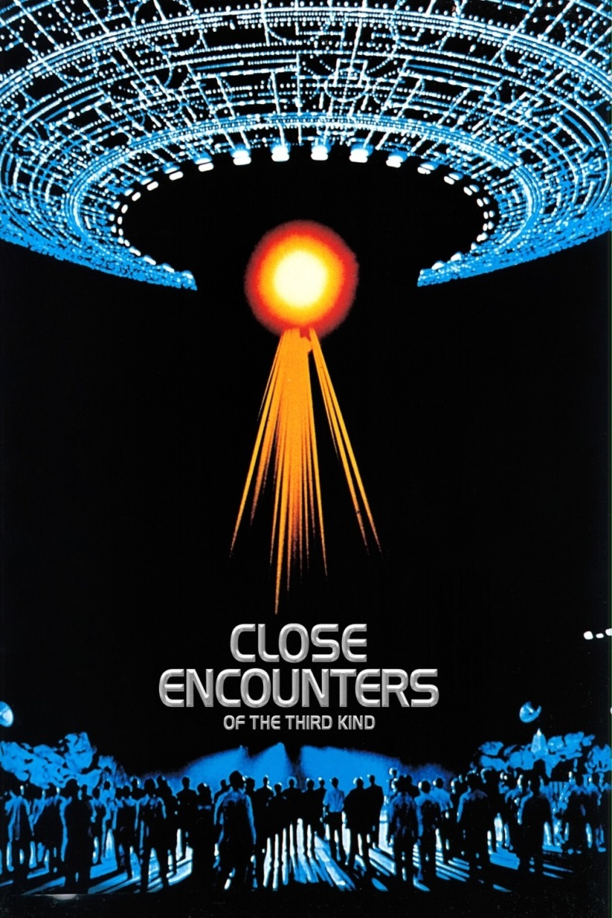
Christian minister / priest reads from Psalm 91:11 before humans chosen to join the aliens.
“For he will command his angels concerning you, to guard you in all your ways.”

Slide 52
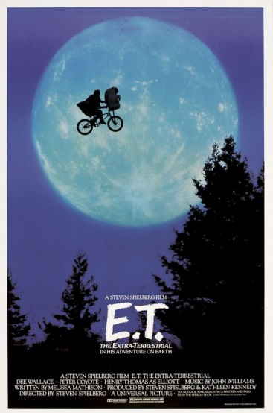
ET possesses powers to heal and fly.
Spiritual connection with Eliot.
Rises from the dead.

Slide 53
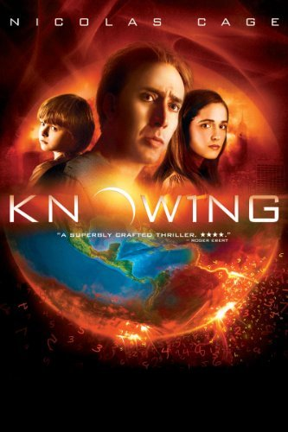
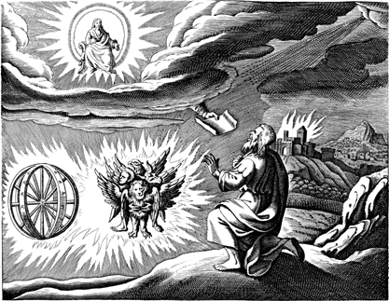

Slide 54
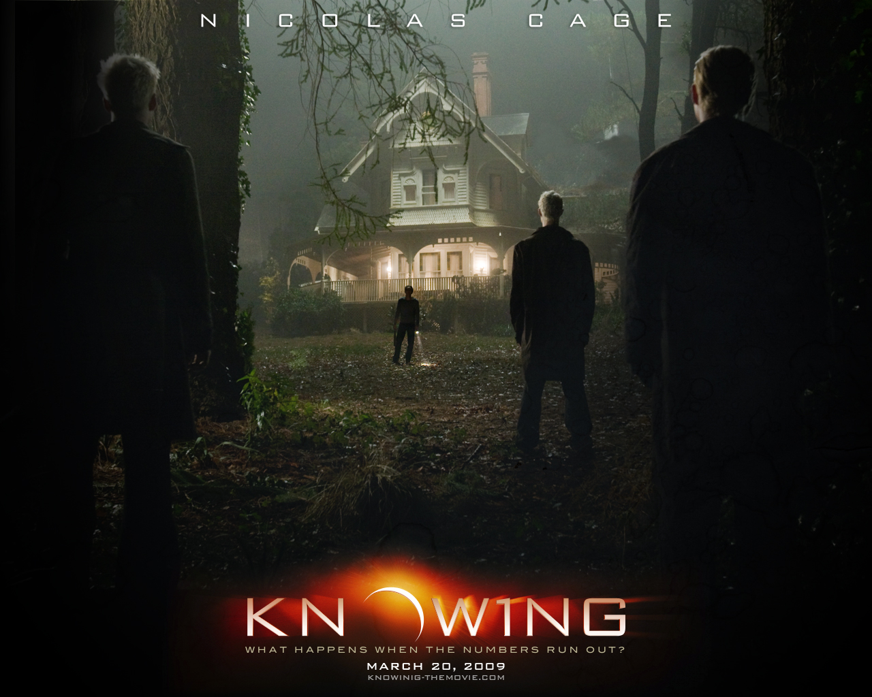

Slide 55
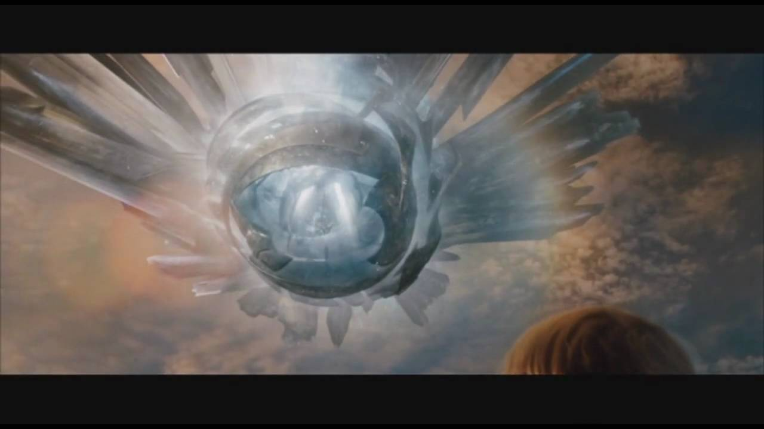

Slide 56
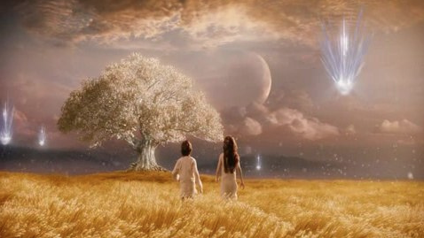

Slide 57
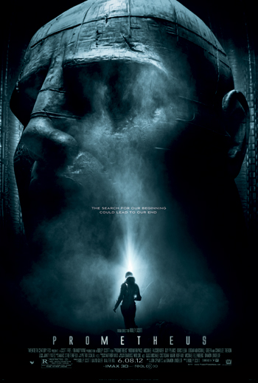
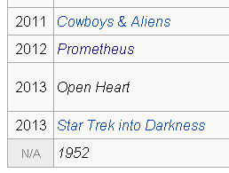
Directed by | Ridley Scott
Produced by | Ridley Scott David Giler Walter Hill
Written by | Jon Spaihts Damon Lindelof

Slide 58
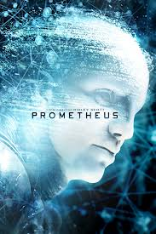
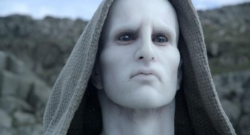
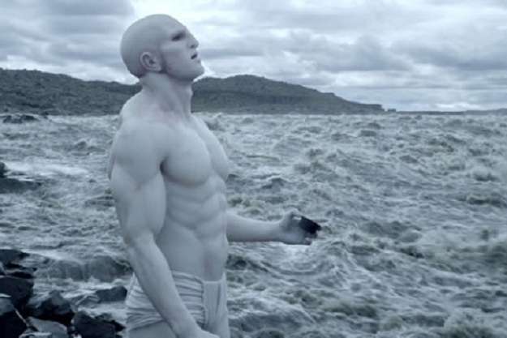

Slide 59
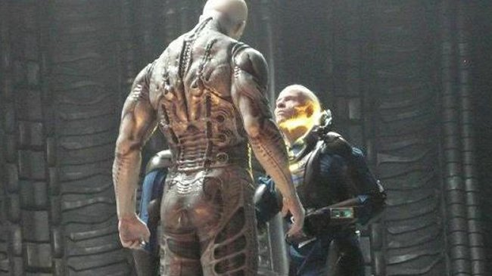
Prometheus

Slide 60
How communicated?
Movies.com: We had heard it was scripted that the Engineers were targeting our planet for destruction because we had crucified one of their representatives, and that Jesus Christ might have been an alien. Was that ever considered?

Slide 61
How communicated?
Ridley Scott: We definitely did, and then we thought it was a little too on the nose. But if you look at it as an “our children are misbehaving down there” scenario, there are moments where it looks like we’ve gone out of control, running around with armor and skirts, which of course would be the Roman Empire. And they were given a long run. A thousand years before their disintegration actually started to happen. And you can say, "Let's send down one more of our emissaries to see if he can stop it." Guess what? They crucified him.

