Slide 1
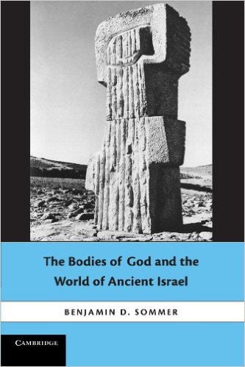
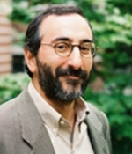
Benjamin Sommer is a Professor of
Bible and Ancient Semitic Languages
at the Jewish Theological Seminary

Slide 2
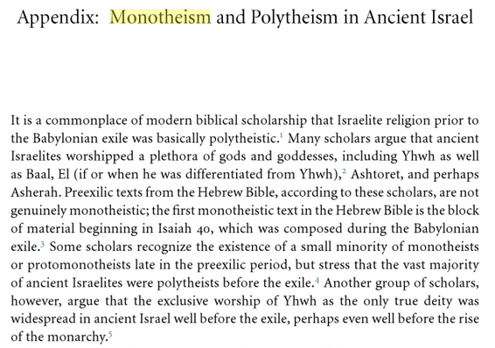
Sommer, Bodies of God

Slide 3
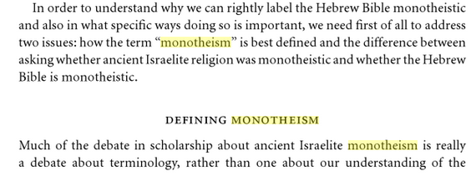

Sommer, Bodies of God

Slide 4
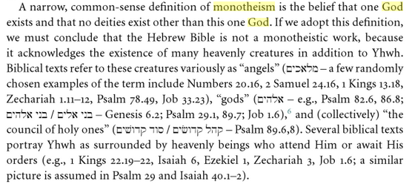
Sommer, Bodies of God

Slide 5
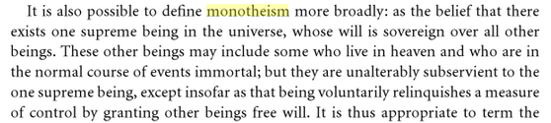
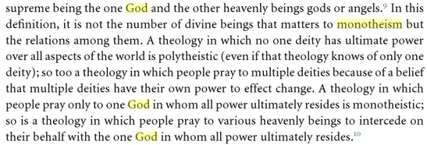
Sommer, Bodies of God

Slide 6
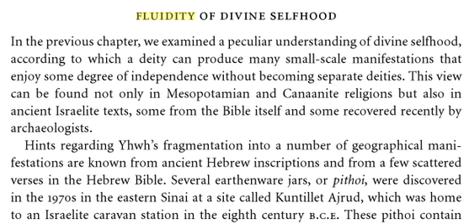

Sommer, Bodies of God

Slide 7
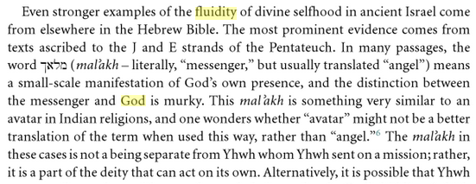
Sommer, Bodies of God

Slide 8
Two slots, top tier

Slide 9
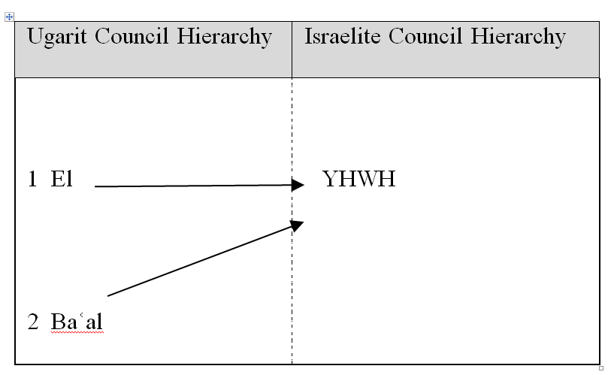

Slide 10
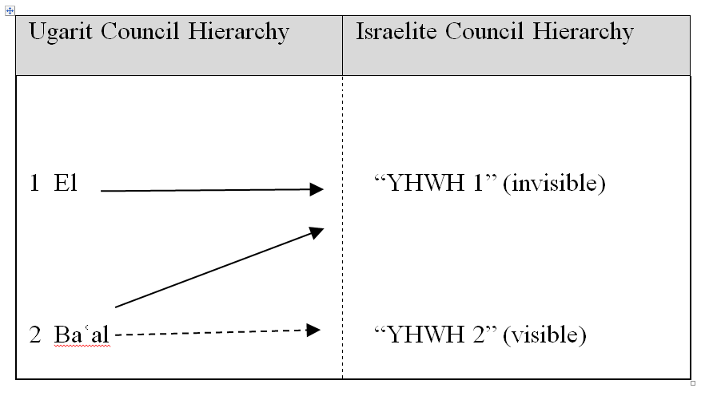

Slide 11
Characterization of the Co-Regency
Anthropomorphic Portrayal (of Baal) as Lord of the Nations
  YHWH’s (anthropomorphized) march to Zion (Deut 33:2, Judg 5:4–5 and Ps 68:8–9, 18–19)
Anthropomorphic Portrayal of Baal as Victorious Warrior
  Joshua 5:13-15
Enthroned in his House-Temple
  Victorious Baal reward with a house-temple
  Deut 4:35-39; 1 Kings 8

Slide 12
Characterization of the Co-Regency
Anthropomorphic Portrayal
Esther J. Hamori, “When Gods Were Men”: The Embodied God in Biblical and Near Eastern Literature (BZAW 384; Berlin: Walter de Gruyter, 2008)
Marjo C. A. Korpel, A Rift in the Clouds: Ugaritic and Hebrew Descriptions of the Divine (Münster: Ugarit-Verlag, 1990)
Sommer, Benjamin D. The Bodies of God and the World of Ancient Israel (Cambridge University Press, 2009)
Stephen L. Herring, Divine Substitution: Humanity as the Manifestation of Deity in the Hebrew Bible and the Ancient Near East (FRLANT 247; Göttingen: Vandenhoeck & Rupprecht, 2013)

