Slide 1
Supernatural Worldview of the Bible
New Testament

Slide 2
Cosmic Geography
Reclaiming the Nations

Slide 3
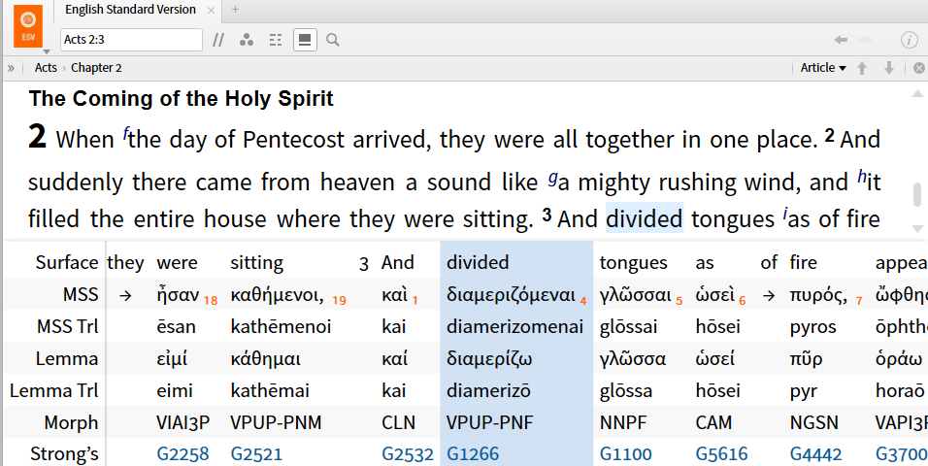
NT Cosmic Geography
Acts 2 – Pentecost

Slide 4
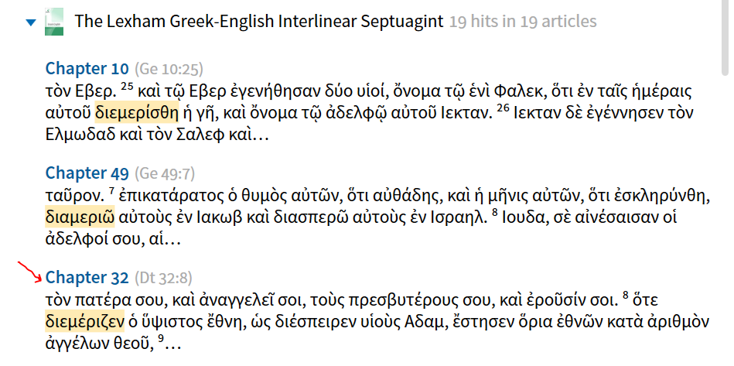
NT Cosmic Geography
Acts 2 – Pentecost

Slide 5
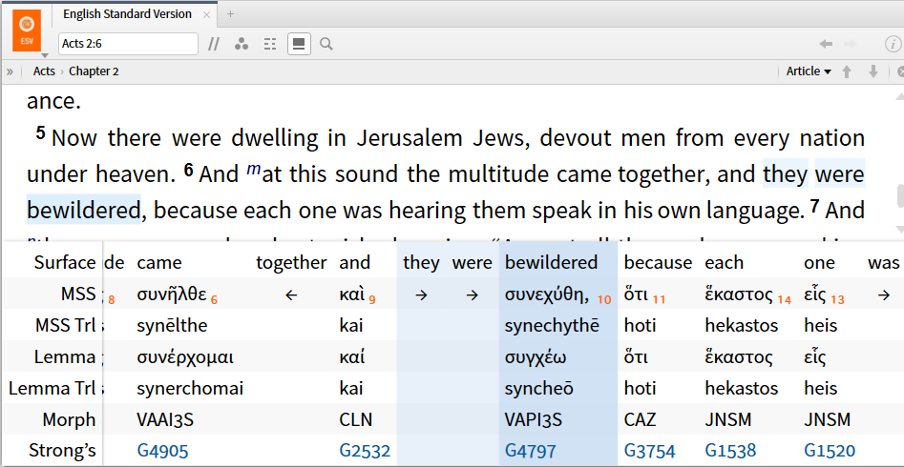
NT Cosmic Geography
Acts 2 – Pentecost

Slide 6
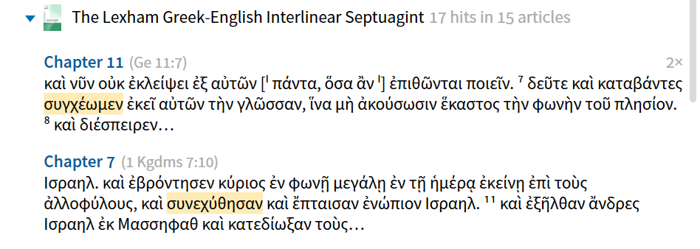
NT Cosmic Geography
Acts 2 – Pentecost

Slide 7
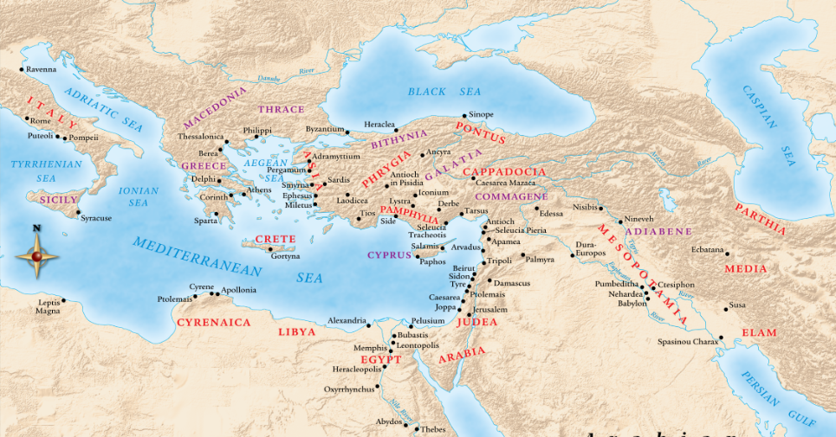
NT Cosmic Geography
Acts 2 – Pentecost

Slide 8
NT Cosmic Geography
Acts 2 – Pentecost
Jerusalem > Judea > (Acts 2-8)
  Samaria (Acts 8)
  Ethiopian Eunuch (Acts 8)
  Saul’s conversion (Acts 9) / Paul
  Gentiles / Nations (cp. Isa 66)
    Damascus (Acts 9)
    Cornelius (Acts 10)
    Missionary journeys to the nations (Acts 11-19)
    Acts 20 – Paul’s arrest > Rome > Spain

Slide 9
NT Cosmic Geography
Acts 20:22 - And now, behold, I am going to Jerusalem, constrained by the Spirit, not knowing what will happen to me there, 23 except that the Holy Spirit testifies to me in every city that imprisonment and afflictions await me.
Acts 21:4- And having sought out the disciples, we stayed there for seven days. And through the Spirit they were telling Paul not to go on to Jerusalem… 10 While we were staying for many days, a prophet named Agabus came down from Judea. 11 And coming to us, he took Paul’s belt and bound his own feet and hands and said, “Thus says the Holy Spirit, ‘This is how the Jews at Jerusalem will bind the man who owns this belt and deliver him into the hands of the Gentiles.'

Slide 10
NT Cosmic Geography
Acts 19:21 ⁻ Now after these events Paul resolved in the Spirit to pass through Macedonia and Achaia and go to Jerusalem, saying, “After I have been there, I must also see Rome.“
    Arrested 54 A.D.; Romans written ca. 56-57
Rom 15:20 and thus I make it my ambition to preach the gospel, not where Christ has already been named, lest I build on someone else’s foundation . . . 23 But now, since I no longer have any room for work in these regions, and since I have longed for many years to come to you, 24 I hope to see you in passing as I go to Spain . . . 28 When therefore I have completed this and have delivered to them what has been collected, I will leave for Spain by way of you.

Slide 12
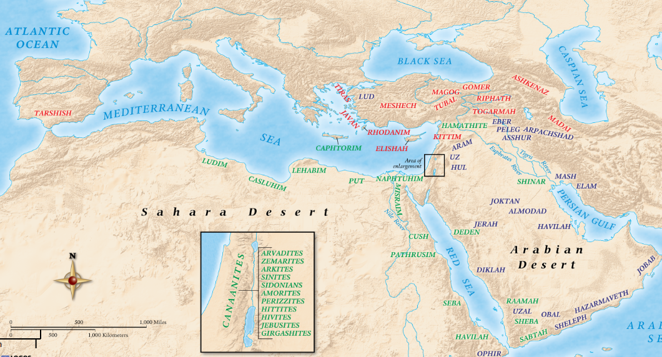

Slide 13
Paul’s Vocab for Powers of Darkness
“rulers” (archontōn or archōn)
“principalities” (archē)
“powers” / “authorities” (exousia)
“powers” (dynamis)
“dominions” / “lords” (kyrios)
“thrones” (thronos)
“world rulers” (kosmokratōr)

Slide 14
Already but Not Yet
Reconstitution of Yahweh’s Council

Slide 15
Edenic Vision
What is the image?
Why the Plurals?
What’s the Point?
  One family, participatory governance
  Heaven meets earth

Slide 16
Reclaiming the Vision
Sons and Daughters of God
The Divine Council Reconstituted

Slide 17
Sons and Daughters of God
John 1:12
1 John 3:1-3
Gal 3:26
Rom 8:14-17
2 Pet 1:4
Heb 2:10-13

Slide 18
The Council Reconstituted
Revelation 2 [Jesus says]:
²⁵ Nevertheless, hold fast to what you have until I come. ²⁶ And the one who conquers and who keeps my works until the end, I will give him authority over the nations, ²⁷ and “he will shepherd them with an iron rod; he will break them in pieces like jars made of clay,” ²⁸ as I also have received from my Father, and I will give him the morning star.

Slide 19
The Council Reconstituted
The morning star language in Rev. 2:28 is messianic—it refers to a divine being who would come from Judah.
We know this by considering two other passages in tandem.
In Num. 24:17, we read the prophecy that “a star will go out from Jacob, and a scepter will rise from Israel.”

Slide 20
The Council Reconstituted
Later in the book of Revelation, Jesus himself refers to his messianic standing with the morning star language:
“I am the root and the descendant of David, the bright morning star” (Rev. 22:16).

Slide 21
The Council Reconstituted
Revelation 3 [Jesus says]:
²⁰ Behold, I stand at the door and knock! If anyone hears my voice and opens the door, indeed I will come in to him and dine with him, and he with me. ²¹ The one who conquers, I will grant to him to sit down with me on my throne, as I also have conquered and have sat down with my Father on his throne.

Slide 22
1 Cor 6:2-3
Do you not know that the saints will judge the world? And if the world is to be judged by you, are you incompetent to try trivial cases? Do you not know that we are to judge angels?
YHWH /
Godhead
sons of God
angels (messengers)

