Slide 1
The Supernatural Worldview of the Bible
Old Testament

Slide 2
Divine Council

Slide 3
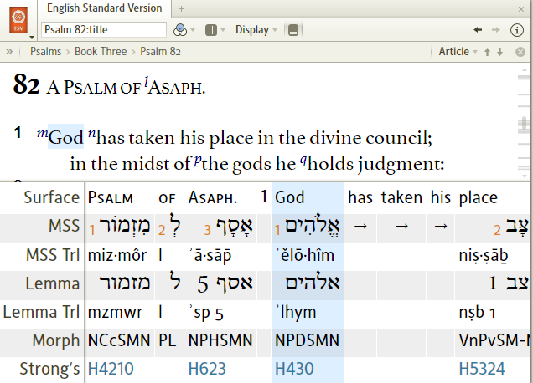
Divine Council

Slide 4
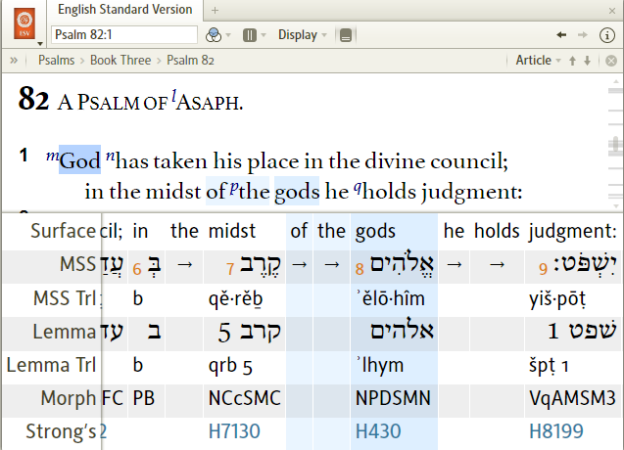
Divine Council

Slide 5
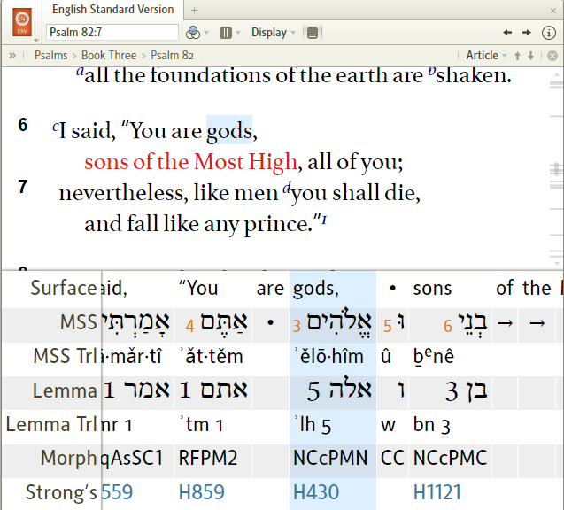
Divine Council

Slide 6
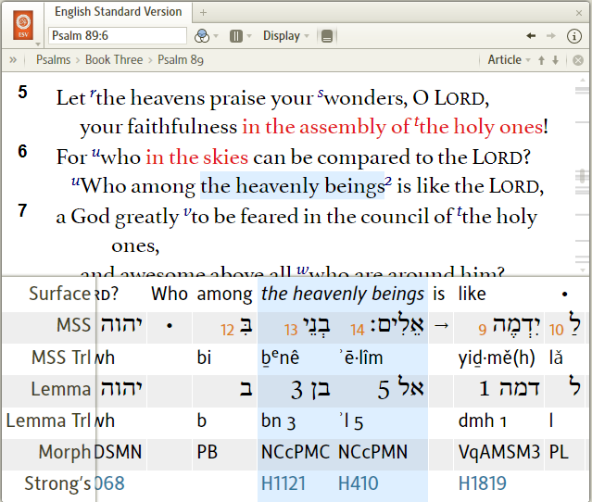
Divine Council

Slide 7
(benê) ʾelohim / ʾelim
“sons of God”
Job 38:7
Job 1:6
Job 2:1
Genesis 6:4
Deuteronomy 32:8 *
Psalm 29:1

Slide 8
God of Israel (YHWH)
“among” or “above” the ʾelohim / ʾelim
Psalm 86:8
Psalm 95:3
Psalm 96:4
Psalm 97:7, 9
Psalm 136:2
Exodus 15:11
Bonus:
Deut 32:17 (NLT)
Other translations?

Slide 9
Incomparability of YHWH
“none besides me”; “none like me”
The phrases are not denials of the existence of other elohim.
They are statements of incomparability.
How do we know that?

Slide 10
Incomparability of YHWH
These “denials” occur in the same chapters and books as those that refer to other elohim (Deut 4, 32)
Deut 32:12
Deut 32:29

Slide 11
Incomparability of YHWH
These “denials” phrases are used elsewhere where denial of existence cannot be possible.
Isa 47:8, 10
Zeph 2:15

Slide 12
How do we understand this?
What about monotheism?
It’s a cultural-context problem, not a theological problem.
Answer right in front of us … in the text

Slide 13
Who is / are ʾelohim?
God of Israel (Psalm 82:1a and other psalms)
The gods of the divine council (Psa. 82:1b, 6)
Gods of various nations (for example…)
  Ashtoreth, the god(dess) [elohim] of the Sidonians, Chemosh, [elohim] of Moab (1 Kings 11:33), Milcom, the god [elohim] of the Ammonites
“Demons” [shedim] (Deut 32:17)
Disembodied human dead (1 Sam 28:13)
Angels (better, one Angel and God) – Genesis 35:1-7 (plural verb; cp. Gen 32, then Gen 48:15-16)

Slide 14
ʾelohim = realm / residence
YHWH / godhead
gods of council
demons
angels
disembodied dead

Slide 15
Divine Council
Limits of council?
YHWH and other beings who are identified with YHWH
YHWH /
Godhead
sons of God
Dt. 32:8-9 / princes of Daniel 10
mal’akim / angels (messengers)
throne guardians
Does God need a council?
Council members in
rebellion (Dt 32, Psa 82)
are excluded (they are in rebellion)
Participatory governance
imaging

Slide 16
The Gods of the Nations

Slide 17
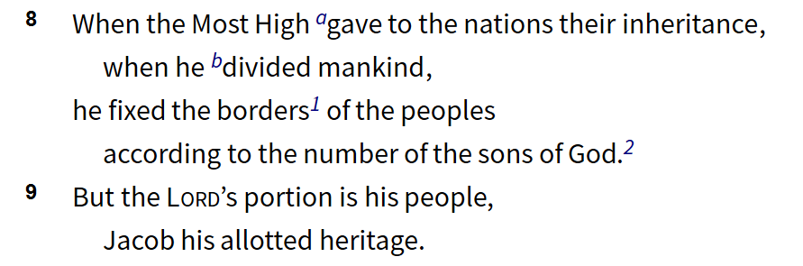
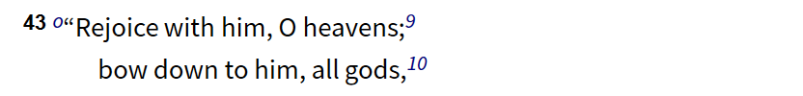
Deuteronomy 32:8-9, 43 (ESV)
Deut 32

Slide 18
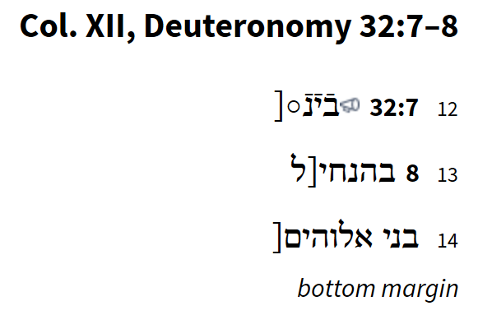
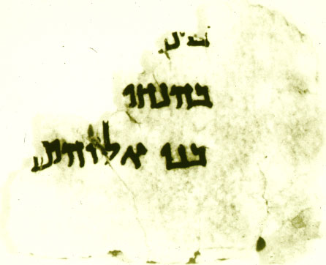

Slide 19
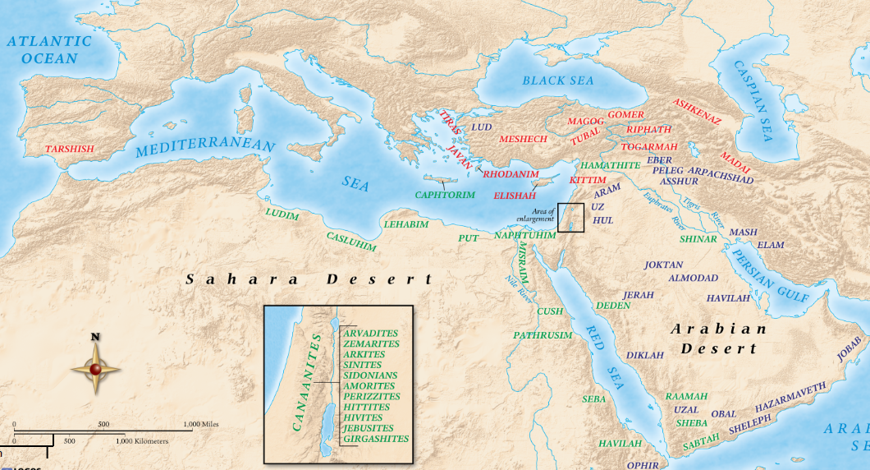
Deuteronomy 32:8-9, 43 (ESV)

Slide 20
OT Cosmic Geography
Genesis 11 = the disinheriting of the nations
Genesis 12 = Call of Abram to create a new for Himself (His “portion” – Deut 32:9); cp. Acts 17:24-27
  Israel vs. the nations (70 – the known world at the time)
  YHWH vs. their gods (“host of heaven” = divine beings)
    Deut 4:19-20
    Deut 17:2-3
    Deut 29:24-26
    Deut 32:8-9
    Deut 32:17
    Deut 32:43

Slide 21
OT Cosmic Geography
Explains a number of passages.
For example:
  1 Samuel 26:17-19
  2 Kings 5:17-19
  Daniel 10:13, 20-21 (cp. Dan 12:1)

Slide 22
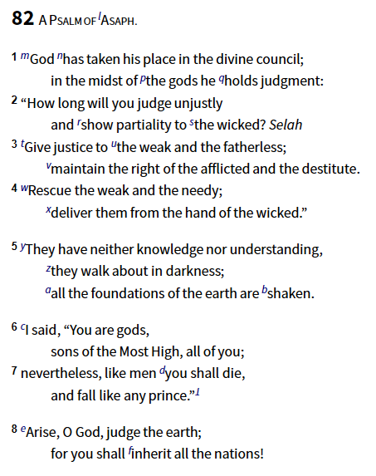

Slide 23
Edenic Vision

Slide 24
Genesis 1:26-27
Then God said, "Let us make man in our image, in our likeness, and let them rule over the fish of the sea and the birds of the air, over the livestock, over all the earth, and over all the creatures that move along the ground." ²⁷ So God created man in his own image, in the image of God he created him; male and female he created them.

Slide 25
Edenic Vision
What is the image?
Why the Plurals?
What’s the Point?
  One family, participatory governance
  Heaven meets earth

