Slide 1
Israel Tour: Day 2
Images: Dr. Heiser

Slide 2
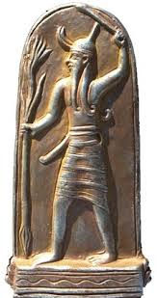
Baal

Slide 3
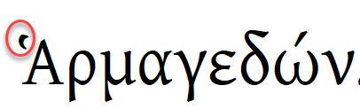
“Armageddon”
Rev 16:15 (Behold, I am coming like a thief. Blessed is the one who is on the alert and who keeps his clothing, so that he does not walk around naked and they see his shamefulness!) And he gathered them to the place called in Hebrew Armageddon.

Slide 4
“Armageddon”
= har magedōn
Mount (הַר) – magedōn
There is no מְגִדּֽוֹן הַר
There is הַר מוֹעֵד

Slide 5
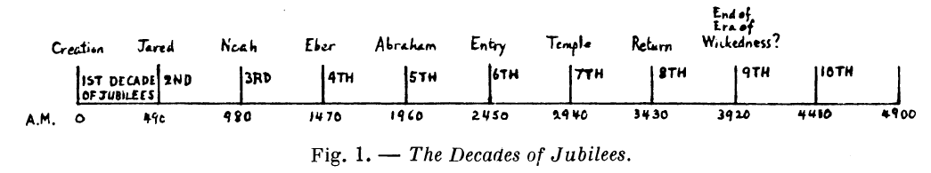
NAZARETH – Essene jubilee
The last 7-year period of this 4900 year grand cycle would begin (in our calendar) between 10 and 6 B.C. and end between 3 B.C. and 2 A.D.

Slide 6
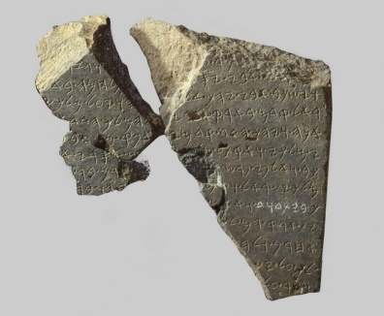

Slide 7
